Slide 1
Yearly Project Progress Review
Intelligent Sensor System for Early Prediction of Sepsis in Neonates & High-Risk Adults
Team:
PI: Prof. Ajay Agarwal, IIT Jodhpur
Co-PIs: Dr. Sudip Bhattacharya, IIT Jodhpur
Prof. (Dr.) Neeraj, AIIMS Jodhpur
Dr. Sanjay Kimbahune, Dr. Paramita Kar Choudhary, & Dr. Sujit Shinde - TCS
01 Sept 2026
Notes:
Yearly review. Narrative: reference fingerprints established for all three biomarkers, two SERS substrate generations built and validated, NAM and LTA trials completed, artifact-screening criterion established. Key remaining challenge is reproducible biomarker detection.

Slide 2

Project Background & Problem Statement
Sepsis is a dysregulated host response to infection and a leading cause of mortality in neonates & critically ill adults.
According to WHO fact-sheet (2024), there are 48.9mn cases of sepsis reported each year globally and 11mn deaths are caused by sepsis.
Around 84-85% of sepsis cases and deaths occur in low- & middle-income countries (LMICs). India has 11.3mn cases & 2.9mn deaths due to sepsis each year, and reported highest number of sepsis-related neonatal deaths as per 2021 data.
Delayed diagnosis is a major problem since current diagnosis depends on blood culture (24–72 h), immunoassays and PCR are accurate, but slow and infrastructure-heavy.
The project aims to develop a fast, reliable and point-of-care method to detect sepsis.

Slide 3
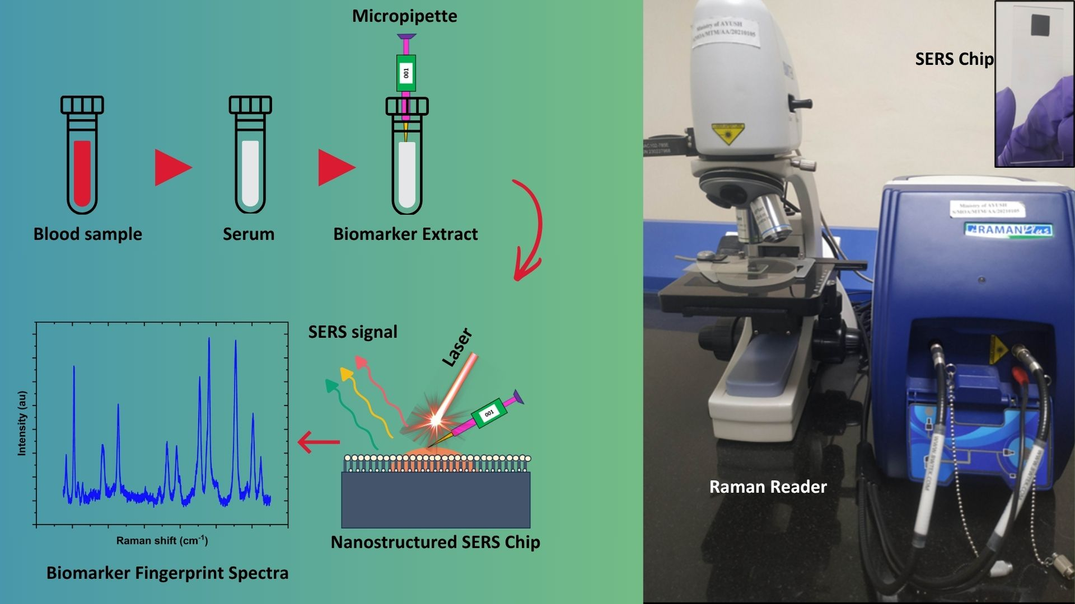
Proposed Solution & Methodology
Biomarker
+
SERS
+
AI
Sepsis
Diagnosis

Slide 4
Project Objectives
Biomarker Discovery
Identify bacterial biomarkers of Gram-positive and Gram-negative sepsis using Raman spectroscopy and purified components.
SERS Platform
Development
Develop and optimize a SERS-enabled nanosensor chip with enhanced Raman signals.
AI-integrated Raman Analysis
Develop machine-learning approaches for automated Raman spectral classification.
Clinical Validation
Point-of-care Prototype
Evaluate the sensor on clinical isolates and patient samples for sensitivity and specificity.
Integrate sensing and analysis into a portable Raman-based point-of-care system.
1
2
3
4
5

Slide 5
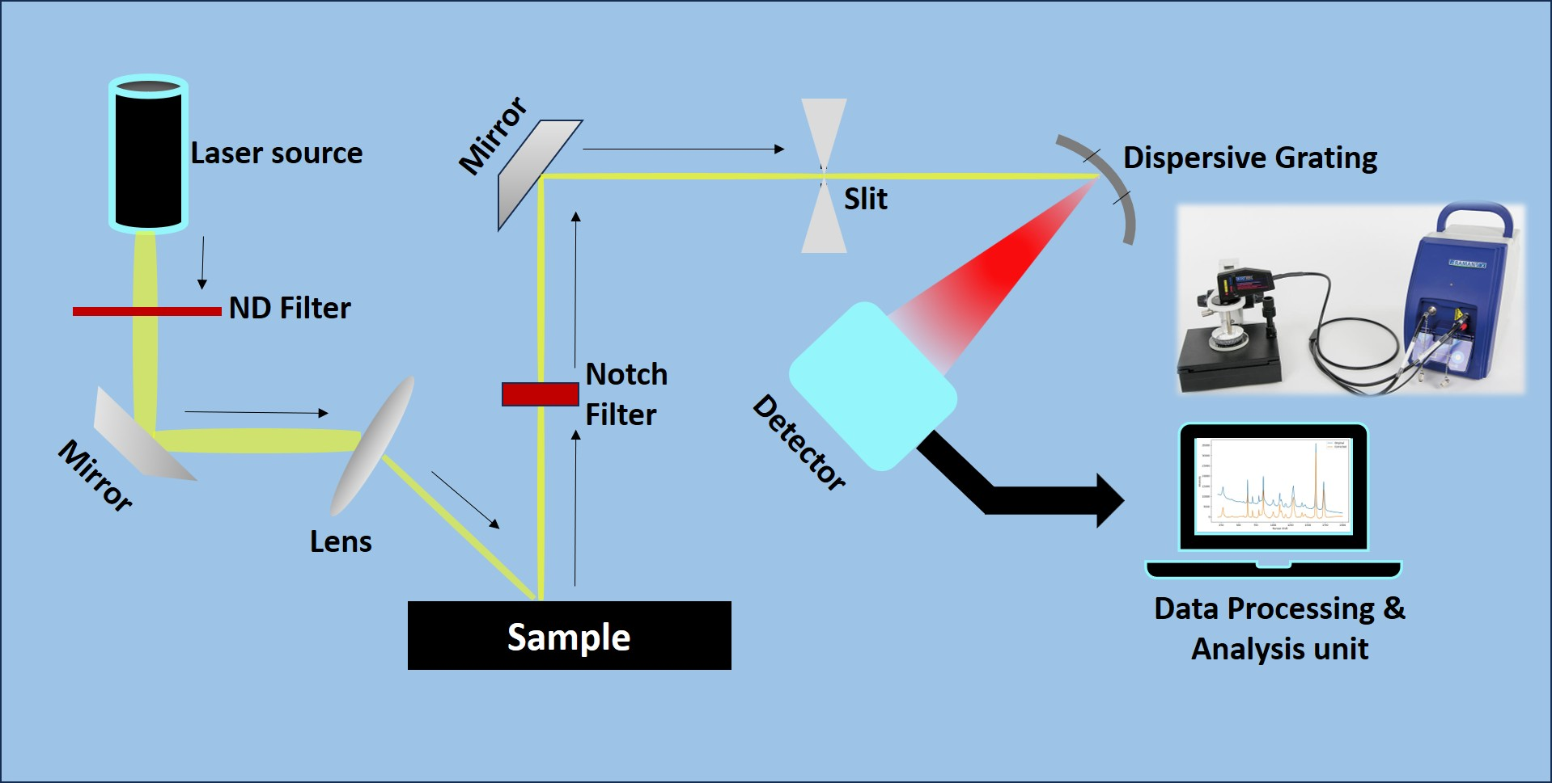
Raman Spectroscopy for Molecular Analysis
A non-destructive spectroscopic technique used to study molecular vibrations and chemical composition.
Based on inelastic scattering of monochromatic light (typically from a laser).
Provides molecular fingerprints for qualitative and quantitative analysis.
Useful for detecting chemical structures, polymorphs, and material phases.
Widely applied in biomedical diagnostics, pharmaceuticals, forensics, and materials science.
Limitations
Signal is weak, so bulk sample is required for detectable signal.
Not suitable for trace analysis.

Slide 6
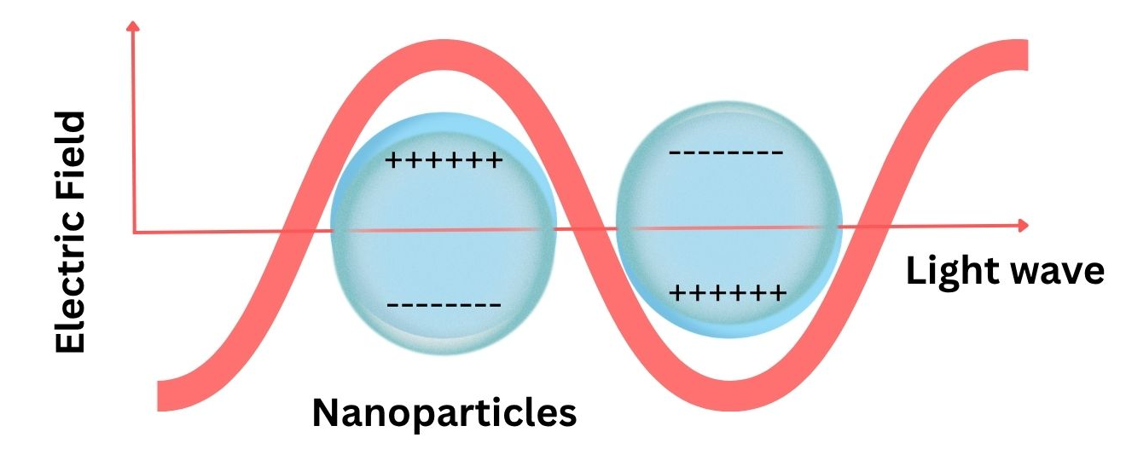
Surface Enhanced Raman Scattering
SERS enhances the Raman signal of trace molecules present at the nano-gaps on the sensor surface.
The enhancement is an effect of localized surface plasmonic resonance (LSPR) created by the noble metal nanoparticles on sensor surface.
Two or more overlapping LSPR regions create ultrasensitive locations called ‘hotspots.’
Such nanosensors may be used for trace contamination detection, trace biomarker detection for early diagnostics etc.

Slide 7
WHERE THIS YEAR SITS IN THE FULL PROGRAMME
Overall Project Roadmap
Biomarker
characterization
DFT
modelling
Pure Raman
reference
SERS substrate
development
SERS biomarker
testing
Complete
Complete
Complete
Complete
In progress
Reproducible
detection
Bacterial isolate
validation
Clinical
validation
AI / ML
classification
Point-of-care
prototype
Next
Future
Future
Future
Future
Position after year one: the computational and experimental Raman foundation is in place and the sensing hardware exists and is validated. The programme now turns from building the capability to achieving reproducible biomarker detection — the gateway to all later phases.

Slide 8
Biomarker Characterization Workflow
NAM / LPS / LTA
selected
DFT modelling
Pure Raman
measurement
Reference
spectrum
SERS testing
Full molecule (NAM)
Fragments (LPS, LTA)
Gram +/- cell-wall targets
Acquisition optimized
by SNR
Theory vs. experiment
comparison
On fabricated
substrates
Applied per biomarker
Biomarker | DFT approach | Pure Raman | Reference outcome | SERS stage
NAM | Full-molecule DFT | Optimized powder Raman (25 s, 80% power, SNR 95.91) | 30/41 matched, MAE 5.73 cm⁻¹ | 643 cm⁻¹ candidate (net +16.8% vs. blank)
LPS | 5-fragment DFT | Optimized powder Raman (60 s, 20% power, 30 acc.) | 26/43 peaks matched (Hungarian), MAE 3.9 cm⁻¹ | Not yet performed
LTA | 3-fragment DFT | Powder Raman | 5/7 bands DFT-supported; 1093.2 cm⁻¹ strongest | Trial on Sensor 2 — artifacts screened

Slide 9
METHODOLOGY · HOW MEASUREMENTS ARE MADE
Raman & SERS Experimental Setup
Parameter | Detail
Spectrometer | B&W Tek (Metrohm) i-Raman Plus, BWS465-785H
Excitation | 785 nm laser, Class 3B, 2048-pixel detector
Resolution | ≈1.4 cm⁻¹ / pixel; range ≈ −46 to 2842 cm⁻¹
Objective | 20× Plan
Substrate | Ag-coated etched-Si (“black-Si”) SERS chip
Sample | Analyte or R6G, drop-cast on substrate, air-dried
Laser power | Set via 0–100 instrument scale
Acquisition | 5–60 s integration, 3–30 accumulations, 400–1800 cm⁻¹

Slide 10
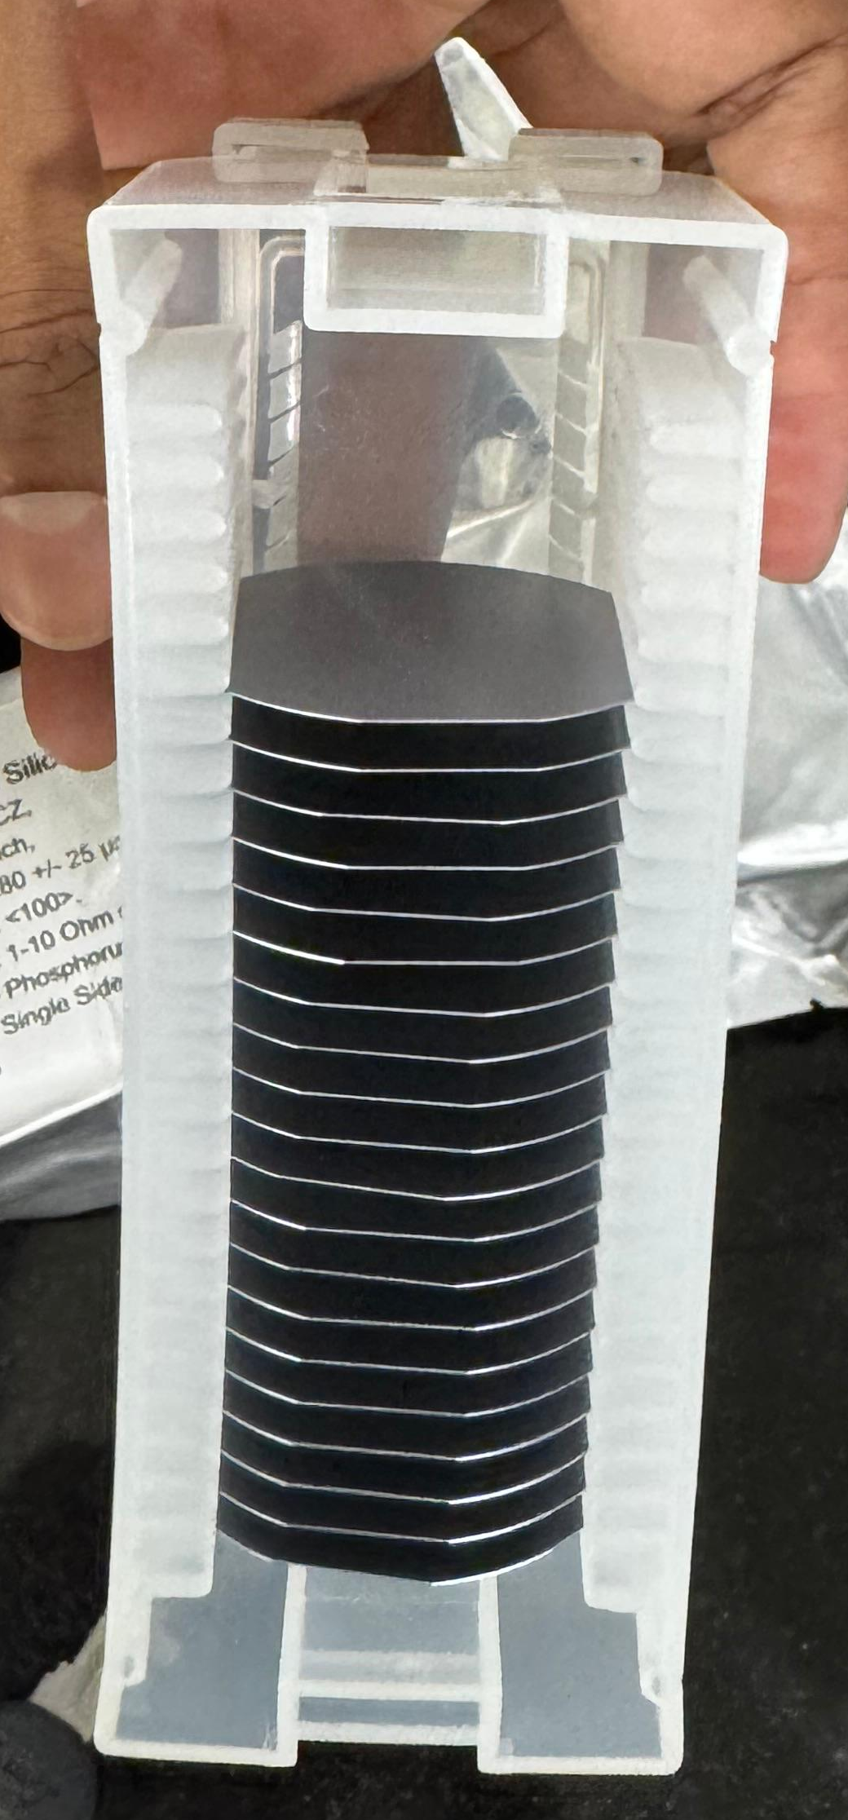
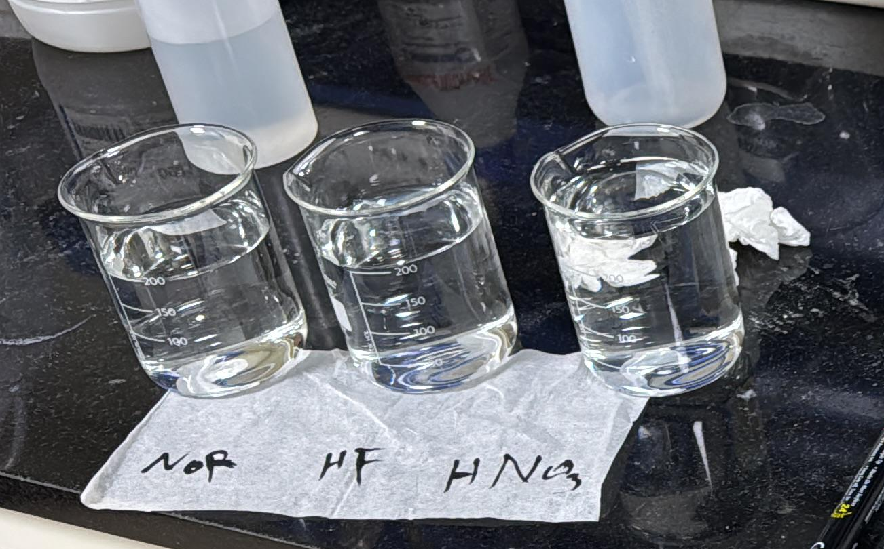

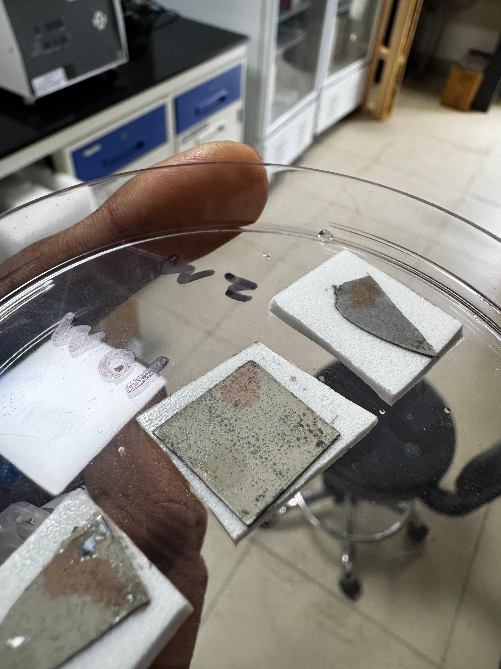
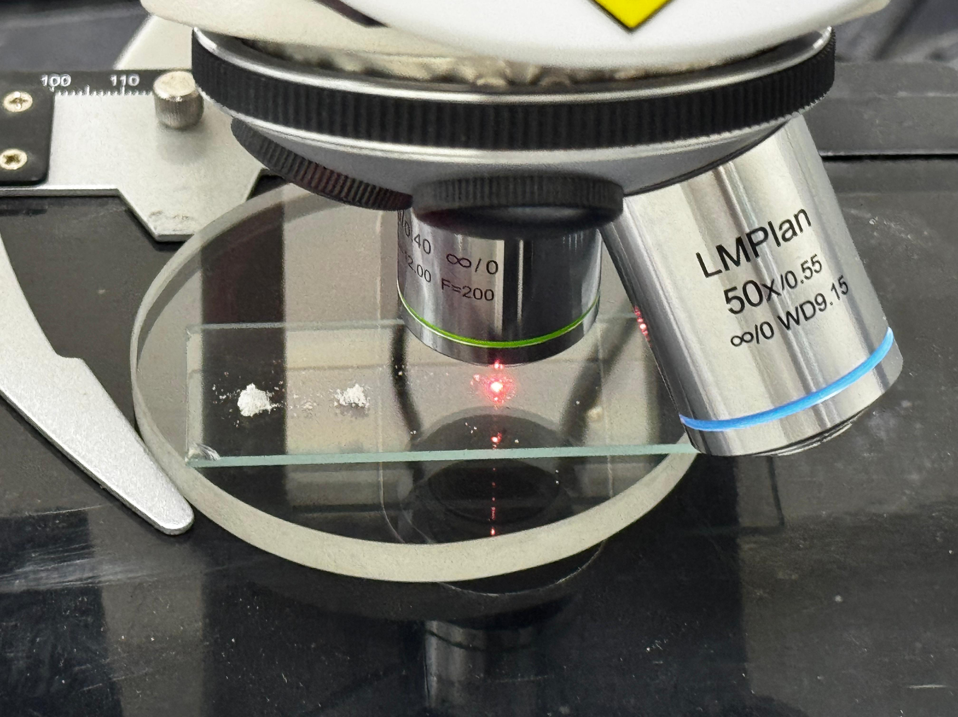
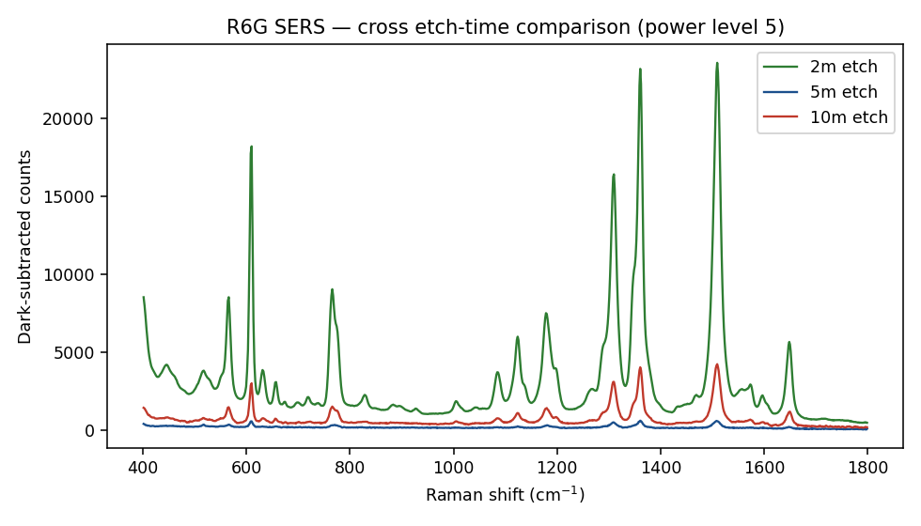
METHODOLOGY · THE SENSING PLATFORM
SERS Substrate: Physical Structure
Si wafer
HF / AgNO₃ etch
Black-Si + Ag
Analyte
785 nm laser
Enhanced signal
Bare crystalline silicon
One-step MACE bath
Etched, silver-coated
Drop-cast, air-dried
Excitation
Plasmonic SERS
Two substrate types validated as SERS-active with R6G: Sensor 1 (Ag/Si) and Sensor 2 (Ag/black-Si, MACE) — 2-minute etch gave the strongest response.
Silver is deposited and silicon is etched simultaneously in one bath (metal-assisted chemical etching) — no separate deposition step.

Slide 11
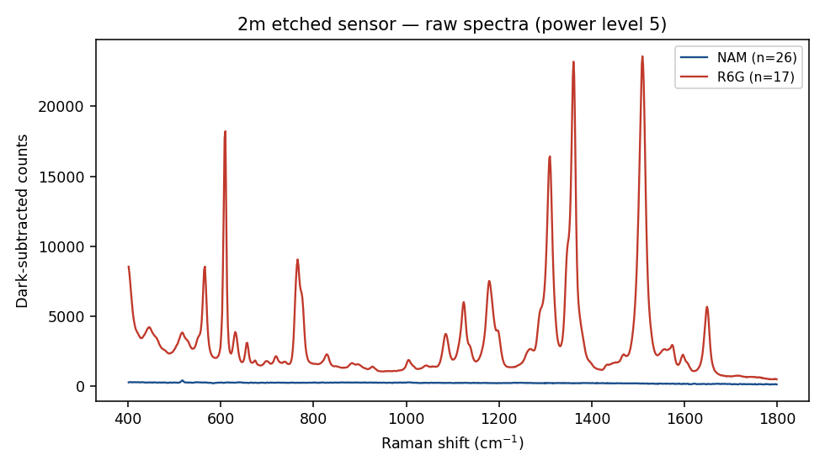
DEVELOPMENT STORY
SERS Substrate Development
Sensor 1
Ag/Si
R6G
validation
Sensor 2
Ag/black-Si
Etch-time
optimization
Best condition
2-minute etch
Biomarker
trials
AgNO₃-assisted
reduction
SERS activity
confirmed
MACE with
HF + AgNO₃
2 / 5 / 10 min
compared
highest response
among variants
NAM and LTA
evaluated
R6G on Sensor 2 across the three etch times: the 2-minute substrate gives the strongest response
R6G and NAM on the best-performing 2-minute etch substrate

Slide 12
SUBSTRATE OPTIMIZATION METHOD
Optimization of Silicon Etching Time Using R6G
Si substrate
HF etching
Ag NP deposition
R6G dilution series
Raman / SERS
Optimum condition
Bare silicon wafer
2 / 3 / 5 / 10 min
AgNO₃ reduction
High → medium → low
Signal + peak quality
Best etch + detection limit
What we're determining
Etching time | R6G concentration series | Response
2 min | High → Low | Compare
3 min | High → Low | Compare
5 min | High → Low | Compare
10 min | High → Low | Compare
Effect of etching time on Ag nanoparticle formation and SERS enhancement
Lowest detectable R6G concentration
Optimum substrate condition giving strong, reproducible and well-defined peaks
Optimum substrate condition = the etching condition showing the highest and most reproducible R6G SERS response at low concentration.

Slide 13
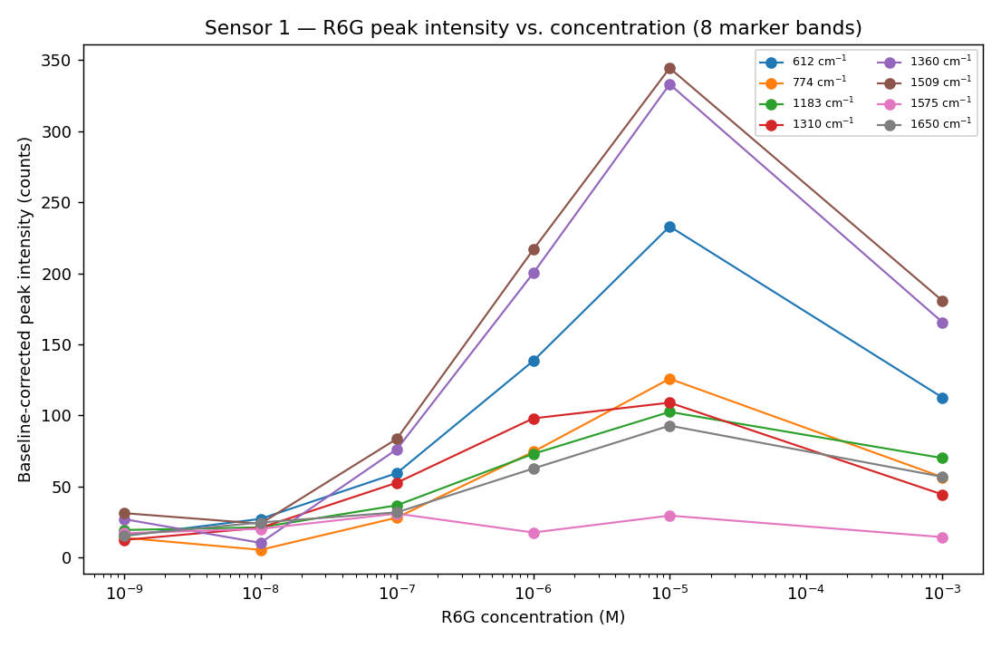
CONFIRMING THE HARDWARE WORKS, BEFORE TESTING BIOMARKERS
R6G — Substrate Validation Probe
R6G is a SERS substrate validation probe — not a sepsis biomarker. Its SERS activity confirms the substrate functions; it is not evidence of biomarker detection.
Sensor 1 — R6G concentration-response, 1 nM–1 mM
Sensor 2 — R6G response across 2, 5 and 10-minute etch substrates
Sensor 1 (Ag/Si)
Sensor 2 (Ag/black-Si, MACE)
SERS-active; measurable concentration response across the tested R6G range
SERS-active; 2-minute etch best among the three variants (SNR ≈343 vs. 188 at 10 min vs. 38 at 5 min)

Slide 14
SAMPLE PREPARATION · HIGH PRIORITY
Sample Preparation and Concentration Series
Biomarker | Stock | Solvent | Concentrations tested | Deposition
NAM | 1 mg/mL (3.41 mM) | DI water | 1 mg/mL | 2–3 µL/spot
LPS | 1 mg/mL | DI water | 1 mg/mL | 2.0 µL/spot
LTA | 1 mg/mL | DI water | - | -
Powder weighed on an analytical balance (±0.1 mg), dissolved directly in DI water — chosen over PBS/DMSO/ethanol so phosphate peaks don't overlap the 800–1100 cm⁻¹ fingerprint region.
LPS and LTA solutions are characteristically hazy (micelle formation) — normal, and not filtered out.
LPS/LTA vortexed (2 min) and bath-sonicated (5–15 min) at the stock stage and before every dilution.
Deposited inside a hydrophobic barrier ring (black-Si is superhydrophilic), then air-dried.
Measurement order per substrate: same-session blank → R6G activity check → analyte across ≥3 (commonly ≥9) spots.

Slide 15
METHODOLOGY · WHY DILUTE?
Rationale for Systematic Dilution Study
High concentration
Possible crowding
Systematic dilution
Reduced interaction
Compare SNR & shape
Optimum concentration
Lowest reproducible spectrum
Dense analyte at surface
Interaction (hypothesis)
Stepwise decade series
...and reduced signal
Across concentrations
Systematic dilution separates three possible causes of a weak or absent signal:
① Insufficient enhancement
The substrate itself is under-performing
② Too little analyte
Not enough molecules reach the surface
③ Poor adsorption chemistry
Analyte doesn't stick to bare silver

Slide 16
PLANNED EXPERIMENT · NEXT STEP
Effect of Biomarker Concentration on Raman/SERS Response
Planned experiment — not yet completed. Concentration-dependent SERS response has not yet been systematically measured for NAM, LPS, or LTA; the design below defines how it will be executed.
Step | Concentration (mg/mL)
Stock | 1
Dilution 1 | 0.1
Dilution 2 | 0.01
Dilution 3 | 0.001
Dilution 4 | 0.0001
Dilution 5 | 0.00001
Parameters to be tracked at each step:
Peak intensity (height & area)
SNR (≥ 3 detection threshold)
Peak position (±5 cm⁻¹ tolerance)
Peak appearance / disappearance
Reproducibility (spot-to-spot & substrate-to-substrate, CV)

Slide 17
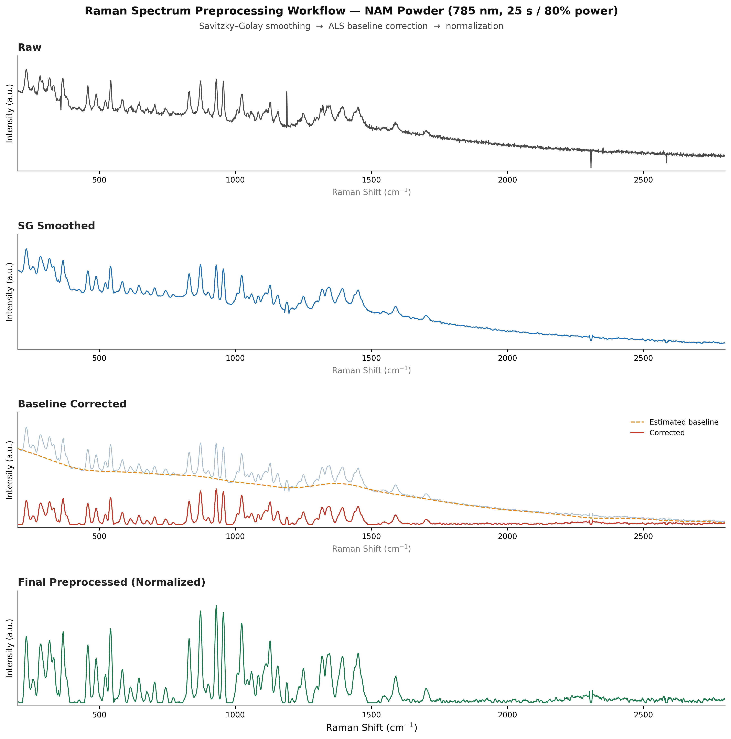
Preprocessing Workflow

Slide 18
TARGET SELECTION RATIONALE
Why NAM, LTA and LPS
NAM
LTA
LPS
N-Acetylmuramic Acid
Lipoteichoic Acid
Lipopolysaccharide
A sugar unique to the peptidoglycan backbone of the bacterial cell wall — present in both Gram-positive and Gram-negative bacteria, absent from human biomolecules.
A defining structural component of the Gram-positive cell wall, anchored in the cytoplasmic membrane and threaded through the peptidoglycan layer.
The major glycolipid of the Gram-negative outer membrane and the principal driver of the host inflammatory response in sepsis (endotoxin).
All three biomarkers are structural cell-wall components, not host-response signals.
5

Slide 19
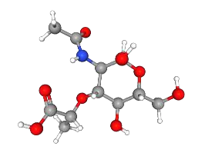
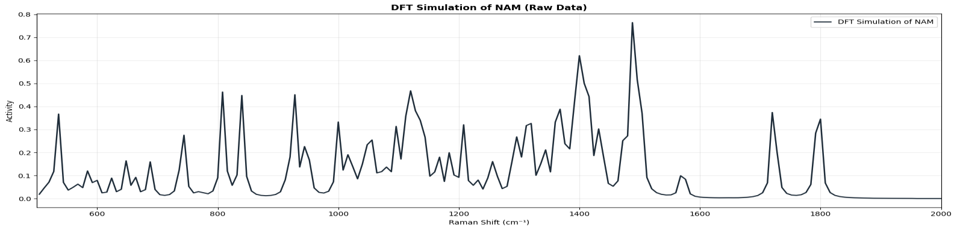
SUPPORTING DETAIL FOR OBJECTIVE 1
NAM Structure, Simulated Spectrum and Peak Matching
Representative matched peaks
Experimental (cm⁻¹) | Simulated (cm⁻¹) | Assignment
872.0 | 872.97 | γ(CH₂) hydroxymethyl wagging
1044.0 | 1042.20 | ν(C–O) + δ(C–O–H)
458.0 | 460.45 | Skeletal bending / ring torsion
646.0 | 640.15 | Skeletal deformation + δ(C–C–O)
1726.0 | 1722.82 | Amide I: ν(C=O)
745.0 | 731.27 | γ(O–H) carboxylic acid out-of-plane
DFT-optimised NAM structure
DFT-simulated Raman spectrum of NAM
(full-molecule model)

Slide 20
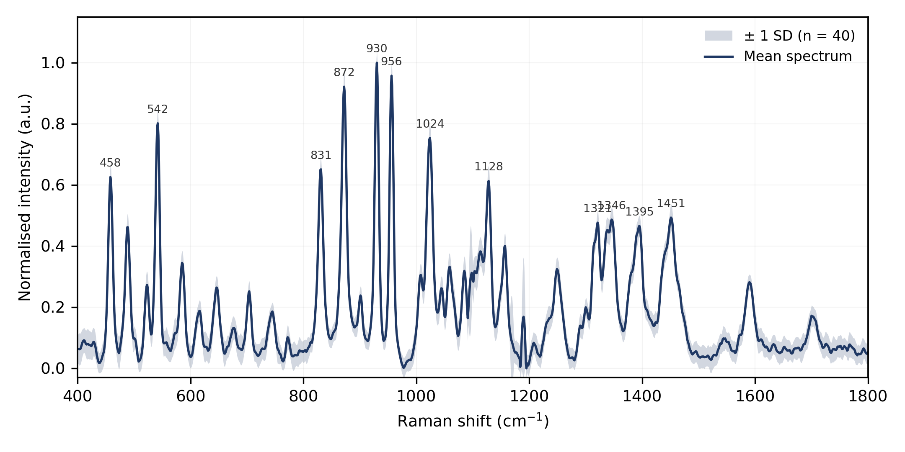
NAM · SAMPLE, INSTRUMENT AND REFERENCE SPECTRUM
N-Acetylmuramic Acid — Setup and Powder Raman
Sigma-Aldrich NAM, ≥98% purity, α/β anomer.
B&W Tek i-Raman Plus, 785 nm, 400–1800 cm⁻¹ analysis window, <3.5 cm⁻¹ resolution.
Two datasets: April optimisation grid (98 spectra, finds safe settings) and May replicate set (104 spectra) — the reference spectrum used throughout is the mean of 22 independent replicates.
Damage threshold established: safe up to 90% power / 30 s; 90% / 60 s destroyed the sample and is excluded from all analysis.
Reference experimental spectrum — mean of replicate measurements, ±1 SD shaded (source: NAM report, Fig. 2).
6

Slide 21
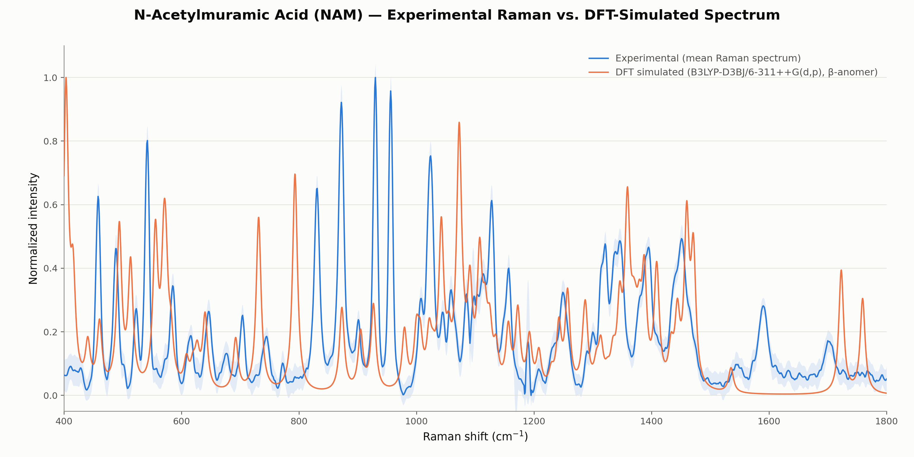
NAM · POWDER RAMAN VS. DFT (Β) AND PUBLISHED LITERATURE
Experimental Agreement Across Two Independent Checks
Comparison | Result
vs. DFT (β-anomer), ±18 cm⁻¹ | 30 / 41 bands matched · MAE 5.73 cm⁻¹
vs. Kouach-Alix et al. (1994), J. Mol. Struct. 327, ±20 cm⁻¹ | Most bands find a literature counterpart; residual offsets attributed to literature sample being pure crystalline α-anomer vs. present α/β powder mixture
Experimental powder Raman overlaid on the β-anomer DFT simulation (source: NAM report, Fig. 5).
8

Slide 22
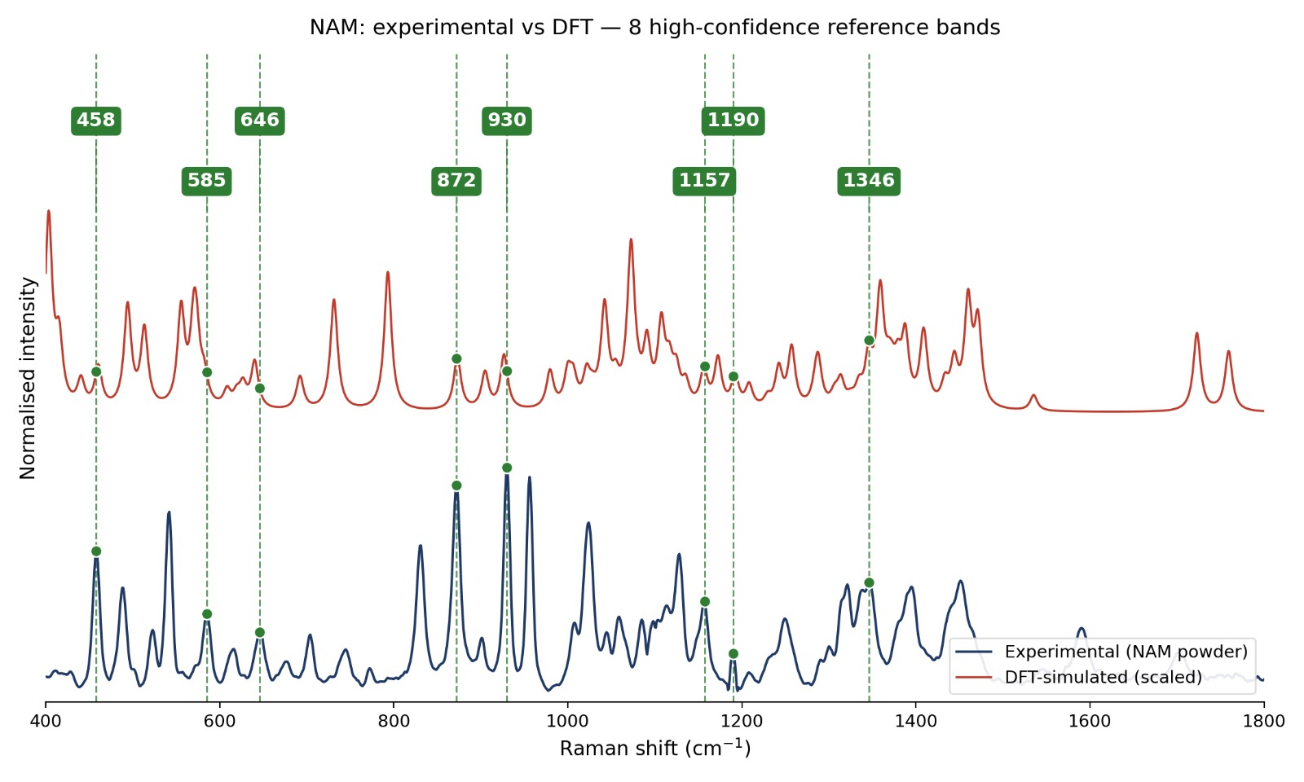

Slide 23
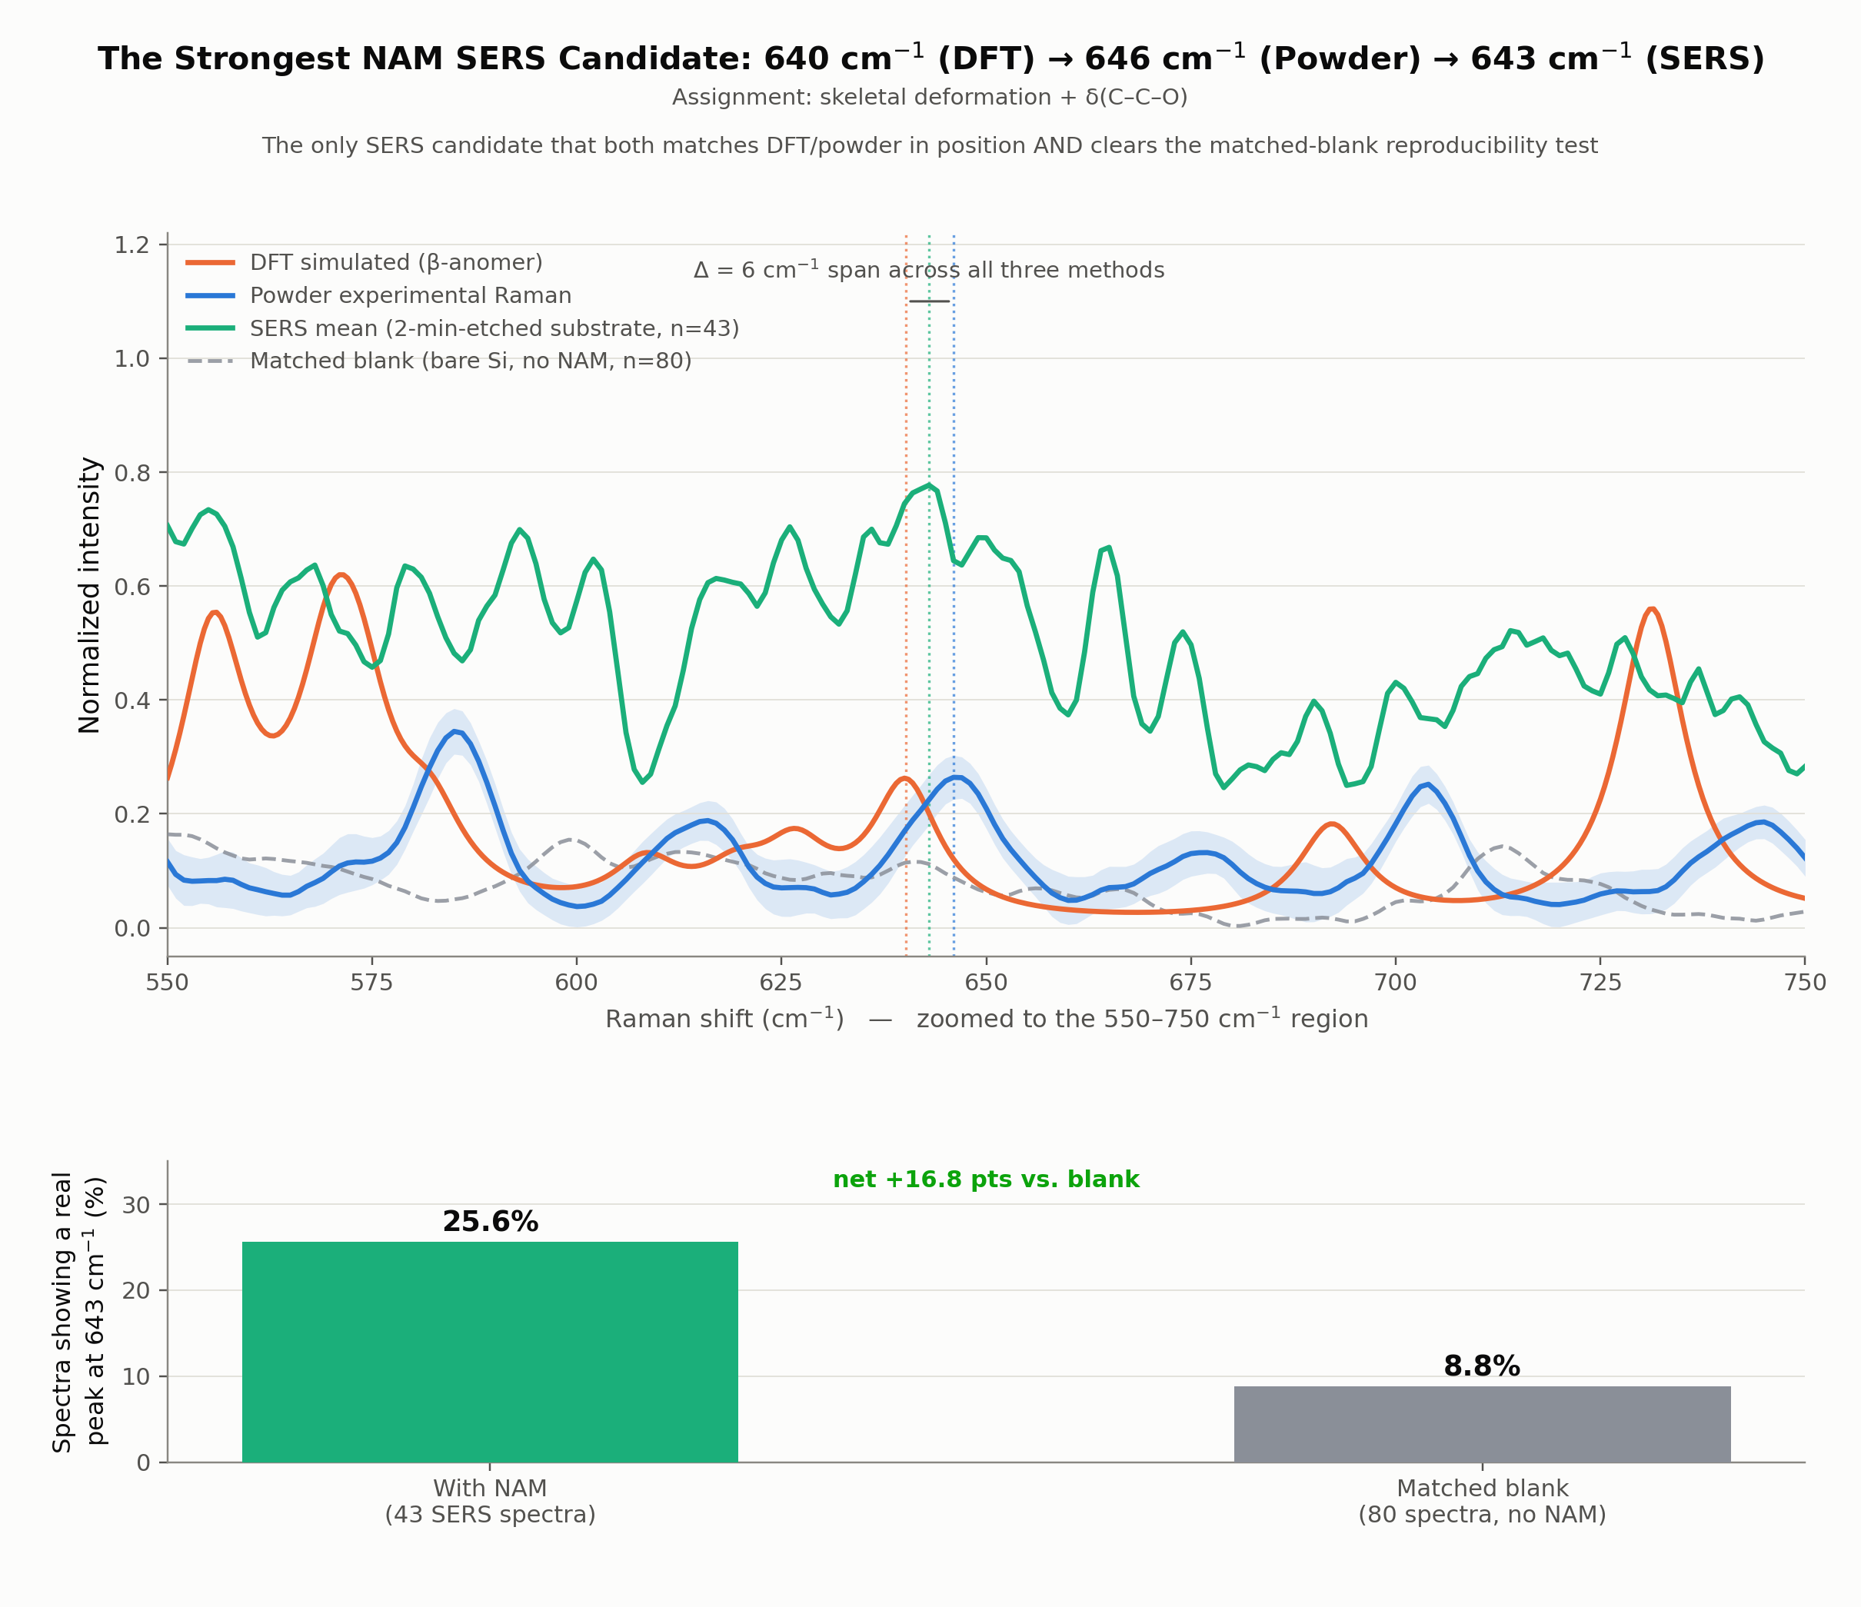
NAM · SERS VALIDATION
The Strongest NAM SERS Candidate: 643 cm⁻¹
DFT (β)
640 cm⁻¹
Powder
646 cm⁻¹
SERS
643 cm⁻¹
25.6% of NAM SERS spectra (n=43) show this peak, vs. 8.8% of matched blank substrate spectra (n=80) — net +16.8 pts.
9

Slide 24
OBJECTIVE 2 · THREE-WAY EVIDENCE CHAIN
NAM: DFT → Powder → SERS → Blank Validation
DFT
Powder Raman
SERS (mean)
Matched blank
Strongest candidate
640 cm⁻¹
646 cm⁻¹
643 cm⁻¹, n = 43
25.6% vs. 8.8%
Net +16.8 points
Evidence | NAM
DFT | 640 cm⁻¹
Powder Raman | 646 cm⁻¹
SERS | 643 cm⁻¹ (n = 43, 2-minute-etch substrate)
Blank control | 25.6% of NAM spectra vs. 8.8% of matched blanks (net +16.8 points)
Status | Strongest candidate — not yet a confirmed detection

Slide 25
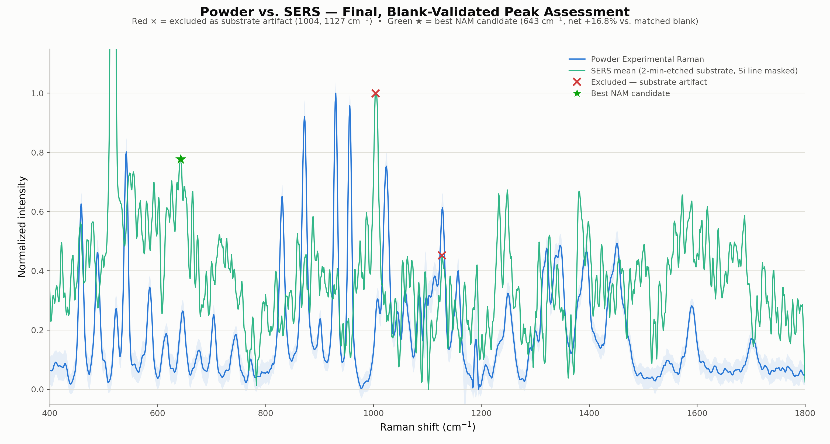
NAM · FINAL VALIDATED SERS ASSESSMENT
Powder vs. SERS — Blank-Validated Outcome
Category | Count | Peaks / notes
Excluded — substrate artifact | 2 | 1004, 1127 cm⁻¹
Best-supported candidate | 1 | 643 cm⁻¹ (net +16.8% vs. blank)
Unconfirmed | 26 | Low single-spectrum reproducibility
SERS's only unambiguous feature is the 517 cm⁻¹ Si phonon line, confirmed via a bare-Si reference and excluded from all NAM peak lists. Of 29 candidate SERS peaks: 2 excluded as artifacts, 1 best-supported candidate, 26 remain unconfirmed rather than proven or disproven.
Red × = excluded substrate artifact. Green ★ = best validated NAM candidate (source: NAM report, Fig. 15).
10

Slide 26
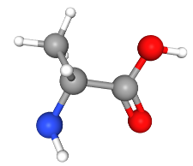
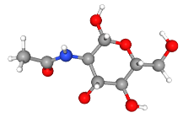
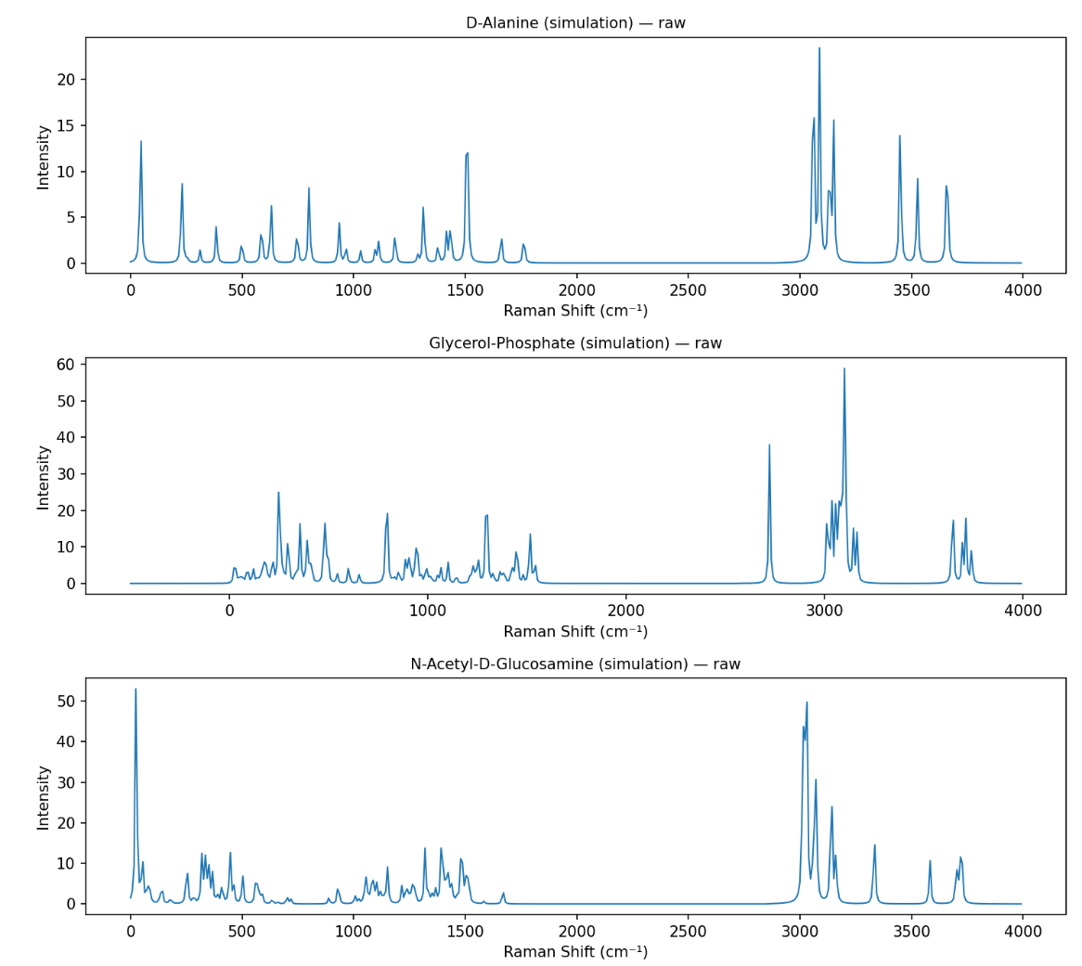
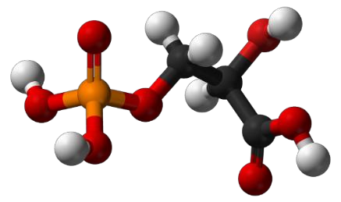
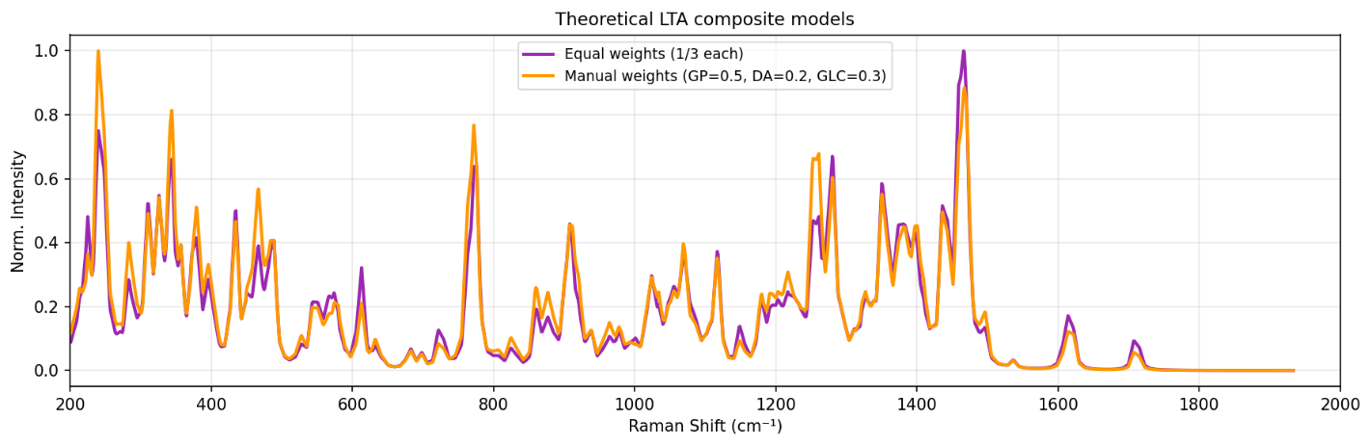
THREE-FRAGMENT DFT APPROACH
LTA Fragment Models and Composite Spectrum
(a) Glycerol-phosphate backbone
(b) D-alanine substituent
(c) GlcNAc substituent
(d) Simulated spectra of the three LTA fragments
Component | DFT-supported band(s)
Glycerol-phosphate | 620.1, 1184.6 cm⁻¹
D-alanine | 999.9 cm⁻¹
GlcNAc | 1093.2, 1602.4 cm⁻¹
(e) Fragment-level DFT reference used for qualitative comparison (not a weighted intact-molecule model)

Slide 27
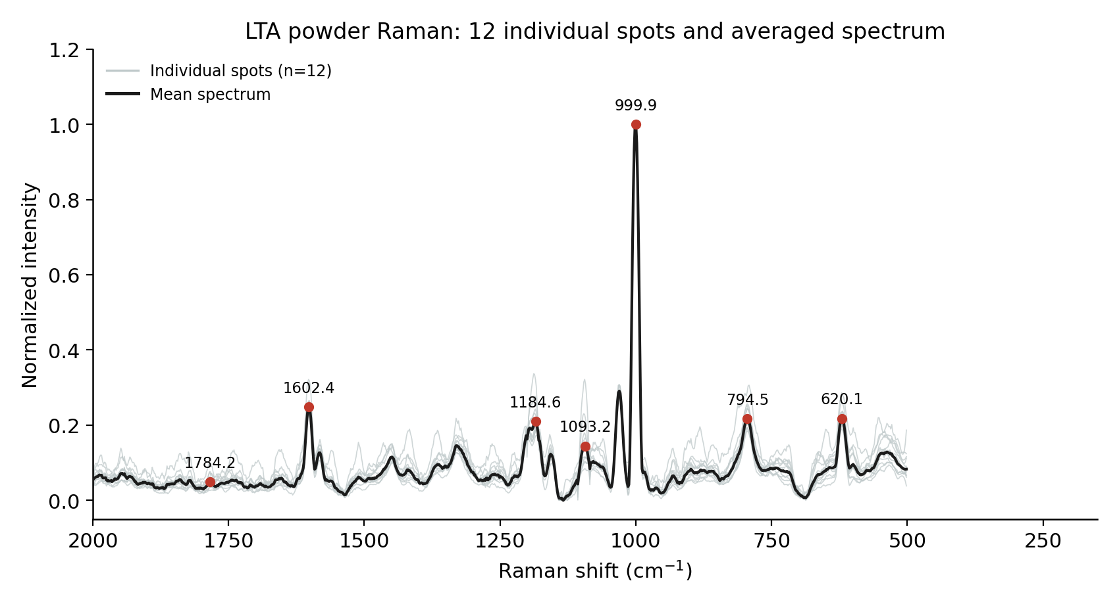
LTA · EXPERIMENTAL POWDER RAMAN
Seven Reproducible Bands, 12 Measurement Spots
Peak (cm⁻¹) | SD | Detect. | Int. CV
620.1 | 0.83 | 12/12 | 10.7%
794.5 | 0.94 | 12/12 | 7.8%
999.9 | 0.45 | 12/12 | 19.9%
1093.2 | 1.95 | 11/12 | 37.5%
1184.6 | 1.72 | 11/12 | 13.2%
1602.4 | 0.61 | 12/12 | 13.2%
1784.2 | 0.00 | 6/12 | 14.9%
Position highly reproducible (SD ≤ 1.95 cm⁻¹) throughout; intensity is not — trust position over intensity.
All 12 individual spot spectra (grey) and the averaged spectrum (black) with the 7 characteristic peaks marked (source: LTA report, Fig. 1).
11

Slide 28
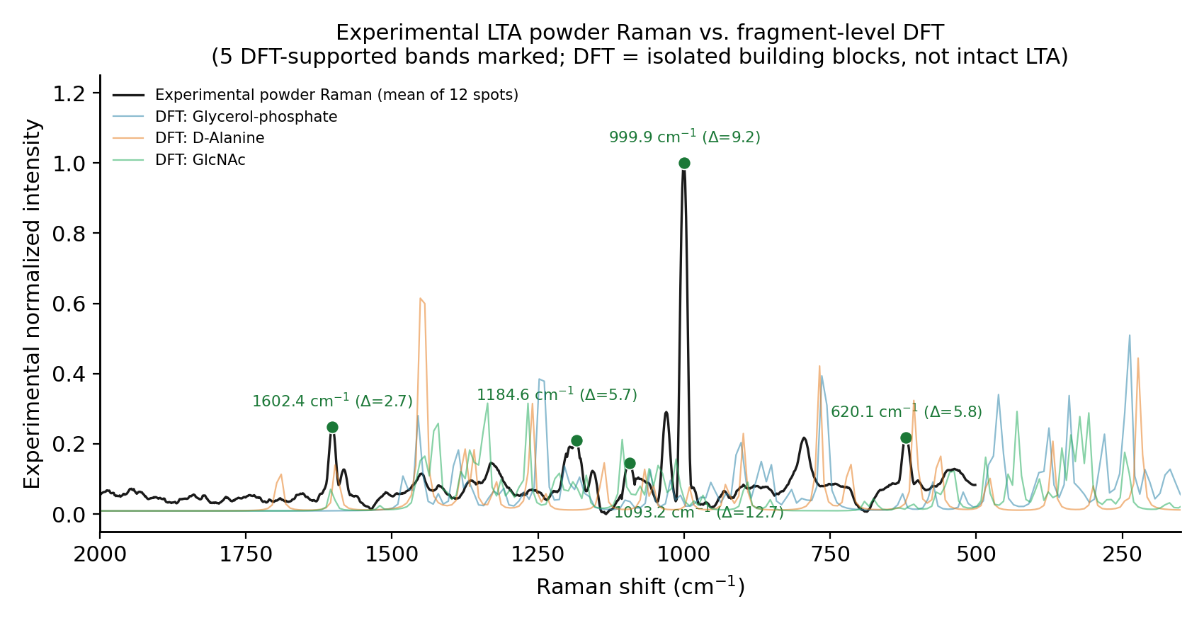
LTA · FRAGMENT-LEVEL DFT VS. EXPERIMENT
Isolated Building Blocks, Not the Intact Molecule
The intact, phosphodiester-linked LTA polymer could NOT be modelled — the whole-molecule Gaussian run failed before reaching the Raman stage. All DFT comparisons here use 3 isolated fragments only: glycerol-phosphate, D-alanine, and GlcNAc.
Result | Value
Matched within ±15 cm⁻¹ | 5 / 7
MAE (matched bands) | 7.2 cm⁻¹
RMSE (matched bands) | 8.0 cm⁻¹
Duplicate DFT assignments | 0 (clean 1:1)
Unmatched | 794.5, 1784.2 cm⁻¹
12

Slide 29
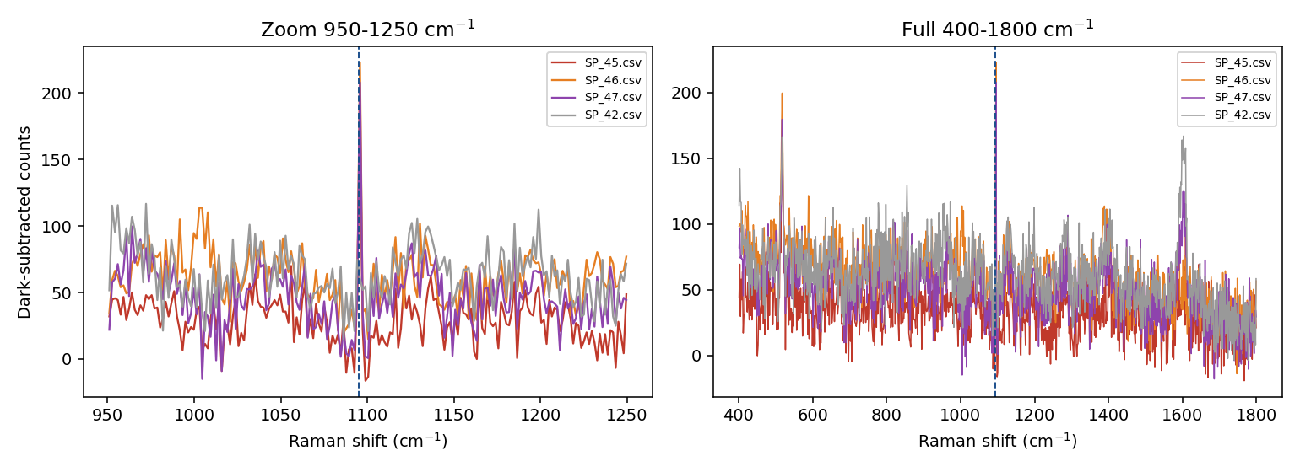
OBJECTIVE 2 · A METHODOLOGICAL ACHIEVEMENT
LTA — SERS Trial and Artifact Validation
Candidate peak
apparent feature at 1095 cm⁻¹
SNR screening
4 of 15 spots met SNR ≥ 3
Pixel-level validation
spectra inspected pixel by pixel
Single-pixel origin
Pixel-level zoom of the apparent 1095 cm⁻¹ feature (SP_45/46/47) — the signal occupies a single detector pixel
traced to one fixed detector pixel
Why this matters
Detector artifact
not a genuine Raman band
A genuine Raman band on this instrument should exhibit a multi-pixel width; a single-pixel spike is a detector artifact. This screening prevented a false-positive LTA result. A second candidate, 1602 cm⁻¹, was separately found to coincide with the blank substrate and is likewise reclassified an artifact — no band yet reaches three-way (DFT + powder + SERS) confirmation.
Rejected
reclassified NOT DETECTED

Slide 30
OBJECTIVE 2 · ARTIFACT CONTROL
LTA: Blank-Controlled Peak Validation
1602 cm⁻¹ — Substrate artifact
Observed at 1602.4 cm⁻¹ (Δ = 2.7 cm⁻¹ vs. DFT) — but an essentially identical peak (Δ = 0.3 cm⁻¹) appears in the same-session blank. Reclassified as a substrate artifact, not an LTA signal.
1095 cm⁻¹ — Retracted
A prior positive claim (apparent SNR 7–9) recurred at the identical single pixel across three consecutive spectra, while a real band spans 4–5 pixels on this instrument. Rejected as a detector artifact and retracted.
1093.2 cm⁻¹ powder reference — status unchanged. Remains the strongest LTA powder reference band (DFT- and literature-adjacent), but SERS detection at this position is still pending / insufficient evidence — not confirmed.

Slide 31
OBJECTIVE 1 · GRAM-POSITIVE MARKER
LTA: Powder Reference → DFT Support → SERS Validation
Powder band (cm⁻¹) | DFT support | SERS status
620.1 | Yes (Δ = 5.8 cm⁻¹, glycerol-phosphate) | Unconfirmed
794.5 | No match ≤ 15 cm⁻¹ | Unconfirmed
999.9 | Yes (Δ = 9.2 cm⁻¹, D-alanine) | Unconfirmed
1093.2 | Yes (Δ = 12.7 cm⁻¹, GlcNAc) | detector artifact
1184.6 | Yes (Δ = 5.7 cm⁻¹, glycerol-phosphate) | Unconfirmed
1602.4 | Yes (Δ = 2.7 cm⁻¹, GlcNAc) | Substrate artifact
1784.2 | No match ≤ 15 cm⁻¹ | Not detected

Slide 32
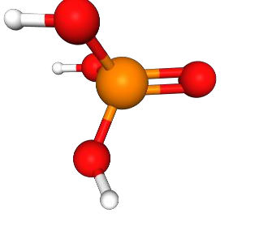
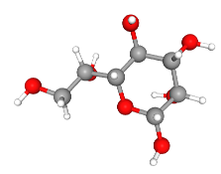
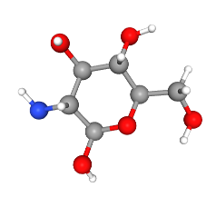
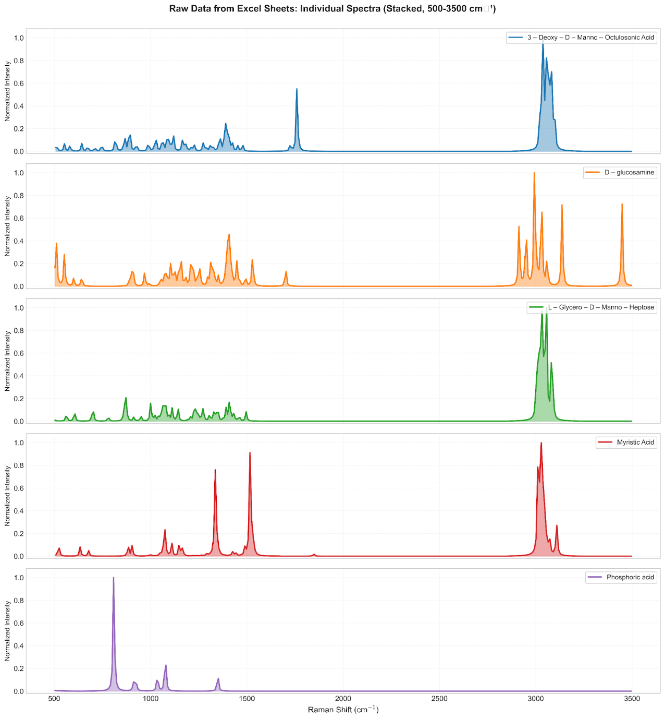
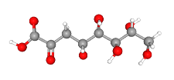

FIVE-FRAGMENT DFT APPROACH
LPS Fragment Models and Simulated Spectra
(a) Kdo
(b)
(c)
(d)
(e)
(a) Kdo, identified in the report; (b)–(e) the four further fragments — D-glucosamine, L-glycero-D-manno-heptose, myristic acid and phosphoric acid
Structural role of each DFT fragment
Fragment | Structural role
Kdo | Core sugar (inner core)
Heptose | Backbone sugar (core)
D-glucosamine | Backbone sugar (lipid A)
Myristic acid | Lipid A acyl chain
Phosphoric acid | Phosphate group
Simulated Raman spectra of the five LPS fragments (normalised, 500–3500 cm⁻¹)

Slide 33
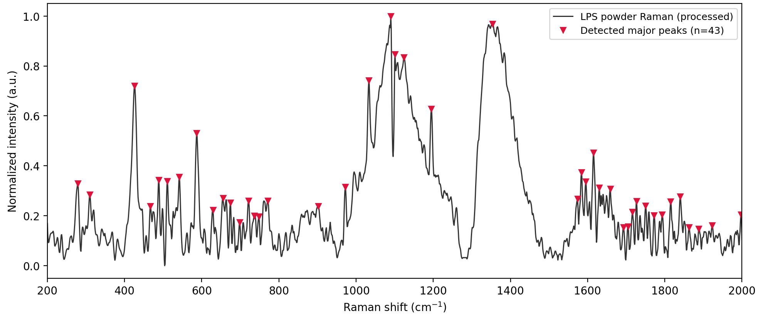
LPS · EXPERIMENTAL RAMAN SPECTRUM
43 Bands Across Three Structural Envelopes
Raman spectrum of LPS powder (E. coli O111:B4, phenol-extracted, S-type), major bands marked, n=43 (source: LPS report, Fig. 1).
Region | Envelope | Dominant band
< 700 cm⁻¹ | Skeletal / ring deformation | —
900–1200 cm⁻¹ | Carbohydrate–phosphate backbone | ~1090 cm⁻¹
1300–1450 cm⁻¹ | Lipid / methylene envelope | ~1350 cm⁻¹
16

Slide 34
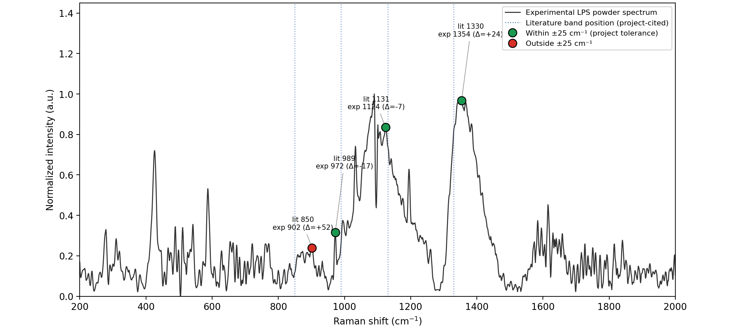
LPS · COMPARISON WITH REPORTED LITERATURE
3 of 4 Literature Bands Confirmed Within Tolerance
Lit. (cm⁻¹) | Exp. (cm⁻¹) | Δ | Assignment
850 | 902 | +52 (outside) | —
989 | 972 | -17 | Carbohydrate ring
1131 | 1124 | -7 | Lipid acyl chain
1330 | 1354 | +24 | Phospholipid CH₂
Experimental LPS spectrum compared with literature-reported Raman bands (source: LPS report, Fig. 5).
3 of 4 literature bands (989, 1131, 1330) fall in close agreement; 850 cm⁻¹ falls outside the ±25 cm⁻¹ project tolerance.
19

Slide 35
AN EXPERIMENT STILL TO BE PERFORMED
LPS — Current SERS Status
LPS SERS measurement has NOT YET been performed.
No LPS SERS spectrum or pure-reference-versus-SERS comparison exists at this stage. LPS SERS remains a planned next experiment, following optimization of the NAM and LTA substrate/adsorption conditions.
Pure Raman characterization
DFT / fragment modelling
Pure-reference comparison
(Hungarian peak-to-mode assignment)
Completed
Completed
Completed
SERS — Sensor 1 (Ag/Si)
SERS — Sensor 2 (Ag/black-Si)
SERS detection
Not yet performed
Not yet performed
Planned next experiment
Not performed ≠ not detected. The LPS reference work is complete; only the SERS measurement step remains outstanding.

Slide 36
OBJECTIVE 1 · GRAM-NEGATIVE MARKER
LPS: Current Status
Stage | Status
Powder Raman | ✓ Done — 43 peaks identified
DFT (5 fragments) | ✓ Done
DFT–powder comparison | ⚠ Moderate — 26/43 matched, MAE 3.9 cm⁻¹
Reference bands | ⚠ 7 candidate bands — not yet a high-confidence set
SERS | NOT PERFORMED
No LPS SERS data exists yet. This is explicitly “not performed,” not a negative result. LPS SERS is the next highest-priority experiment.

Slide 37
EVERY SAMPLE, EVERY STAGE
Consolidated Experimental Results
Sample | Pure Raman | DFT | SERS
NAM | ✓ | ✓ | ⚠ 643 cm⁻¹ candidate (net +16.8% vs. blank)
LTA | ✓ | ✓ | ⚠ 1095 & 1602 cm⁻¹ artifacts; 1093.2 cm⁻¹ unconfirmed
LPS | ✓ | ✓ | — Not yet performed
R6G (validation probe) | — | — | ✓ SERS-active on both substrate generations
✓ Completed
⚠ Attempted / in progress
— Not performed
Reading this table: the reference layer (Pure Raman + DFT) is complete for all three biomarkers. On the SERS layer, NAM now has a matched-blank-validated candidate (643 cm⁻¹); LTA's two candidate peaks are explained as artifacts; LPS SERS remains to be measured.

Slide 38
WHAT THIS YEAR DELIVERED
Key Scientific Achievements
1
Three biomarkers characterized
2
DFT Raman modelling completed
3
Pure Raman reference spectra established
NAM, LPS and LTA selected and fully characterized as Gram +/- cell-wall targets.
Full-molecule model for NAM; validated fragment-based approach for LPS and LTA.
Optimized, reproducible reference spectra for all three biomarkers.
4
30/41 NAM bands matched with DFT
5
Two SERS substrate types fabricated
6
Both substrates demonstrated SERS activity
MAE 5.73 cm⁻¹ — β-anomer confirmed as reference model via a statistical test rejecting the alternative α-anomer hypothesis.
Sensor 1 (Ag/Si) and Sensor 2 (Ag/black-Si via MACE).
Confirmed independently using the R6G validation probe.
7
Best MACE condition identified
8
NAM and LTA SERS trials completed
9
Artifact-screening criterion established
2-minute etch outperformed the 5- and 10-minute Sensor 2 variants.
NAM's 643 cm⁻¹ candidate passed matched-blank validation (net +16.8%); LTA trial screened two artifact peaks.
Multi-pixel peak-width AND matched-blank statistical validation now applied project-wide — prevented false positives and surfaced NAM's strongest candidate.

Slide 39
OBJECTIVE → WORK PERFORMED → STATUS
Progress Against Original Objectives
Biomarker Discovery
DFT + optimized pure-powder Raman for NAM, LTA and LPS; theory-vs-experiment comparison
Substantially complete
1
SERS-Based Sensing Technology
Two substrate generations fabricated and validated with R6G; NAM's 643 cm⁻¹ candidate identified, LTA trial completed
In progress
2
AI-Integrated Raman Analysis
Structured Raman datasets and preprocessing pipeline provide the foundation
Not started
3
Clinical Validation
Requires reproducible biomarker detection first
Not started
4
Point-of-Care Prototype
Requires validated sensing and analysis components
Future stage
5
Progress bars are indicative of stage completion, not quantitative metrics.

Slide 40
AGAINST THE FOUR PROPOSAL DELIVERABLES
Deliverable Progress
1
Raman spectral library
Reference dataset established;
expansion ongoing
Pure-standard Raman reference data established for NAM, LTA and LPS, cross-validated against DFT. Expansion to additional bacterial components continues.
2
SERS chip
Two generations fabricated &
validated; optimization ongoing
Sensor 1 (Ag/Si) and Sensor 2 (Ag/black-Si, MACE) both fabricated and confirmed SERS-active with R6G; best etch condition identified. NAM SERS on the 2-minute-etch substrate has produced a matched-blank-validated candidate at 643 cm⁻¹.
3
AI-based Raman analysis algorithm
Data-generation /
preparation stage
Structured Raman datasets and a consistent preprocessing pipeline are being produced — the required input for model development in a later phase.
4
Point-of-care prototype
Future stage
Depends on validated sensing and analysis components; scheduled for a later phase of the programme.

Slide 41
COMPLETED · IN PROGRESS · NEXT
Current Project Status
COMPLETED
IN PROGRESS
NEXT
DFT modelling — NAM, LTA, LPS
Pure Raman characterization
Reference spectra established
SERS substrate fabrication (2 generations)
R6G substrate validation
NAM SERS trial (643 cm⁻¹ candidate)
LTA SERS trial (1095, 1602 cm⁻¹ artifacts ruled out)
Artifact-screening criterion
Substrate optimization
Biomarker adsorption optimization
Measurement reproducibility improvement
Raman reference library expansion
LPS SERS measurement
Concentration-dependent NAM detection
Concentration-dependent LTA detection
Further substrate optimization
The critical path runs through reproducible biomarker detection — every later objective depends on it.

Slide 42
IMMEDIATE EXPERIMENTS VS. LATER PROJECT PHASES
Next Steps
IMMEDIATE
LATER PROJECT PHASES
Next experiments in the current work package
Sequenced after reproducible detection is achieved
1
Optimize substrate fabrication and reproducibility
Phase 2
Validation on cultured bacterial / clinical isolates
2
Optimize biomarker–surface adsorption conditions
Phase 3
Clinical patient-sample validation
3
Improve measurement reproducibility across batches
Perform LPS SERS measurement on both substrates
Phase 4
AI / ML Raman classification
4
5
Confirm the 643 cm⁻¹ NAM candidate with a concentration series
Point-of-care prototype development
Phase 5
6
Target 1093.2 cm⁻¹ in a new LTA SERS measurement

Slide 43
CROSS-BIOMARKER SUMMARY
NAM vs LTA vs LPS: Overall Status
Parameter | NAM | LTA | LPS
Pure powder Raman | ✓ | ✓ | ✓
DFT | ✓ Full molecule | ✓ Fragments | ✓ Fragments
DFT–powder comparison | ✓ | ✓ | ⚠ Exploratory
Reference bands | 30/41 matched (refined) | 7 powder bands | No high-confidence set
SERS | ✓ (643 cm⁻¹ candidate) | ✓ trial (no confirmed match) | Not performed
Blank control | ✓ | ✓ | —
Validated SERS candidate | 643 cm⁻¹ (strongest, not confirmed) | None confirmed | —
Next step | Concentration series | Optimization / validation | SERS measurement

Slide 44
TRANSLATION · FROM BENCH TO BEDSIDE
Clinical Translation & End-User Pathway
Clinical problem
Biomarker ID
SERS sensor
AI interpretation
Point-of-care system
Sepsis, delayed diagnosis
NAM / LPS / LTA
Substrate + measurement
Spectral classification
Bedside deployment

Slide 45
Conclusion
Established the computational and experimental Raman foundation — DFT models and pure reference spectra for NAM, LTA and LPS.
Developed and validated two types of SERS substrates, both confirmed SERS-active using R6G.
Completed NAM and LTA SERS trials — identified NAM's first matched-blank-validated candidate (643 cm⁻¹) and ruled out two LTA artifact peaks (1095, 1602 cm⁻¹).
Established a rigorous approach for distinguishing genuine spectral features from detector artifacts.
The key next challenge: confirming the 643 cm⁻¹ NAM candidate with a concentration series, and extending matched-blank validation to LPS and LTA (targeting 1093.2 cm⁻¹).

Slide 46
Thank You
Questions and discussion

Slide 47
Backup / Additional Results
Supporting technical detail for discussion and Q&A

Slide 48
DFT COMPUTATIONAL PARAMETERS
Backup — DFT Computational Parameters
Parameter | NAM (full molecule) | LTA fragments | LPS fragments
Functional | B3LYP-D3BJ | B3LYP | B3LYP
Basis set | 6-311++G(d,p) | 6-31G(d) | 6-31G(d)
Job type | Opt + Freq + Raman | Opt + Freq + Raman (Gaussian 09) | Opt + Freq + Raman
Solvation | Gas phase (none) | Not stated in source | Not stated in source
Grid / SCF | UltraFine / Tight | UltraFine / Tight | UltraFine / Tight
Resources | 16 processors, 48 GB RAM | 16 cores, 56 GB RAM | 16 cores, 56 GB RAM
Pure-standard Raman acquisition
Parameter | NAM | LTA | LPS
Sample form | High-purity powder (~98%) | Powder / prepared solution | Powder / prepared solution
Excitation source | 785 nm laser | 785 nm laser | 785 nm laser
Optimum condition | 25 s integration, 80% power, best SNR = 95.91 | 20 s integration, power level 20, | 60 s integration, 20% power, 30 accumulations

Slide 49
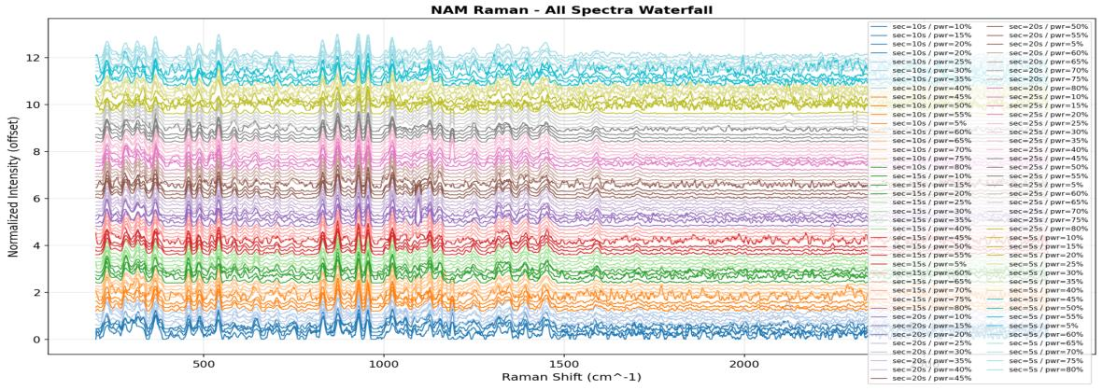
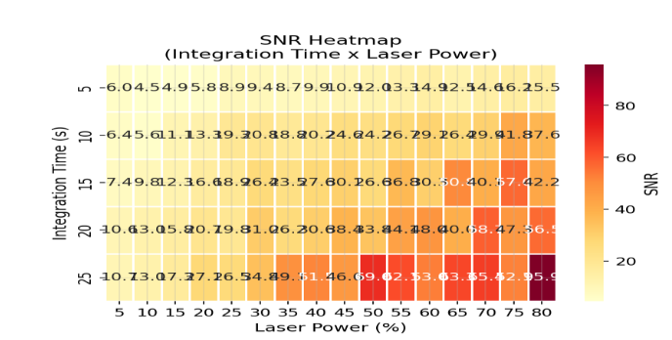
SELECTING THE REFERENCE MEASUREMENT CONDITION
Backup — NAM Acquisition Optimisation
Experimental Raman spectra of pure NAM powder across laser power / integration-time settings
SNR map across the tested parameter combinations
Selected condition: 25 s integration · 80% laser power · best SNR = 95.91 — chosen by comparing SNR across all tested combinations. The reference spectrum used throughout is the mean of 22 replicates from the May replicate set (sets R2+R4).

Slide 50
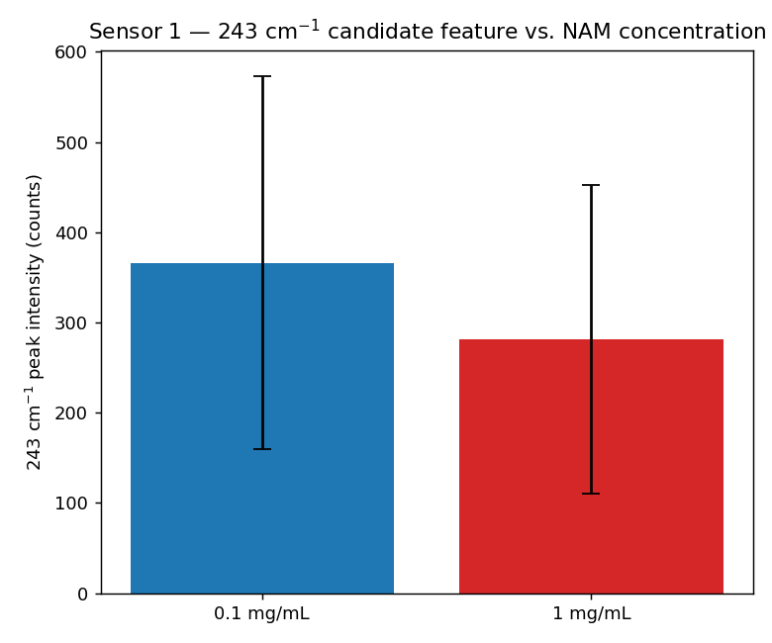
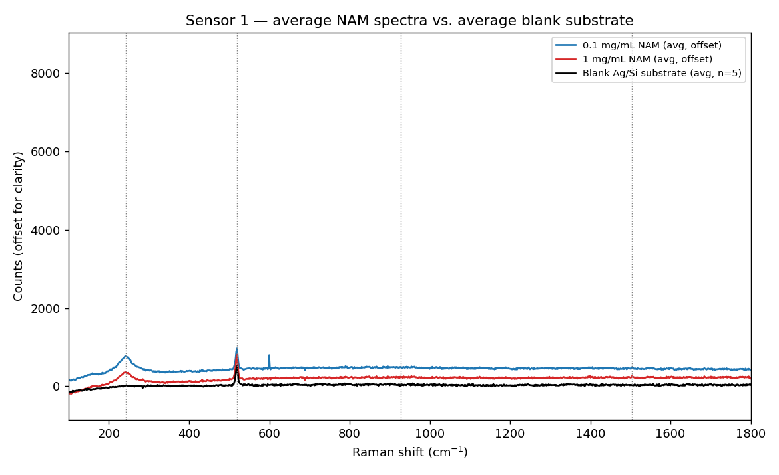
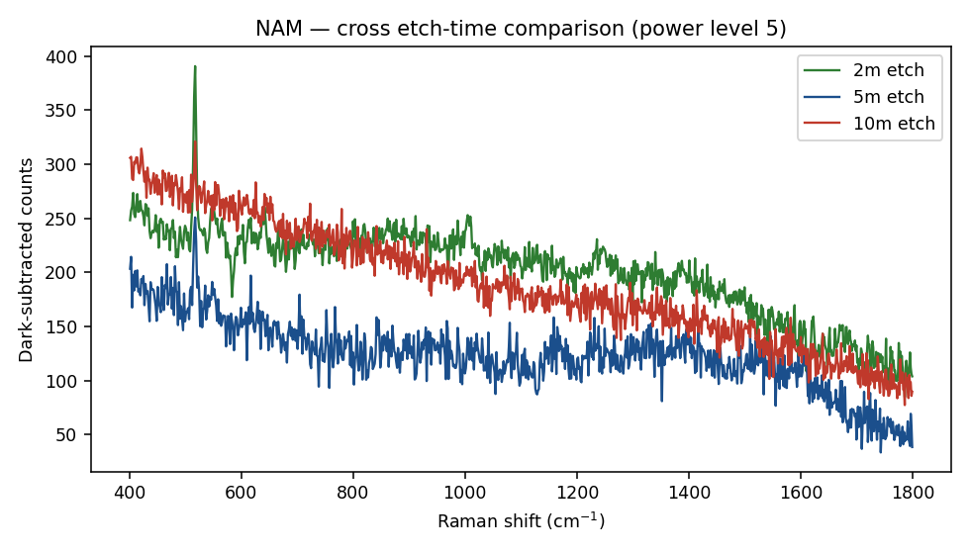
PRIOR SENSOR-LEVEL DATA
Backup — NAM SERS Trial Detail
NAM (1 mg/mL) on Sensor 1 vs. blank-substrate spectrum
~243 cm⁻¹ candidate peak intensity vs. NAM concentration (mean ± SD)
NAM on Sensor 2 across 2, 5 and 10-minute etch substrates
Category | Detail
Excluded — substrate artifact (2 peaks) | 1004 cm⁻¹ (35.0% of blanks vs. 11.6% with NAM) and 1127 cm⁻¹ (37.5% vs. 2.3%) — more common in the blank, so excluded as substrate features.
Best-supported NAM candidate (1 peak) | 643 cm⁻¹ — seen in 25.6% of NAM spectra vs. 8.8% of matched blanks (net +16.8%). Aligns with the 646 cm⁻¹ powder Raman band and 640 cm⁻¹ DFT mode (skeletal deformation + δ(C–C–O)).
Unconfirmed (26 peaks) | Low single-spectrum reproducibility on both NAM and blank sides. The two contamination-risk peaks (1381, 1573 cm⁻¹) stayed clean in both datasets.

Slide 51
SERIAL DILUTION PROTOCOL
Backup — NAM Concentration-Series Preparation
Step | Volume | Final concentration
Stock | 1 mg/mL | 1 mg/mL
Dilution 1 | 1 mL stock + 9 mL DI water | 0.1 mg/mL
Dilution 2 | 1 mL of 0.1 mg/mL + 9 mL DI water | 0.01 mg/mL
Dilution 3 | 1 mL of 0.01 mg/mL + 9 mL DI water | 0.001 mg/mL
Dilution 4 | 1 mL of 0.001 mg/mL + 9 mL DI water | 0.0001 mg/mL
Dilution 5 | 1 mL of 0.0001 mg/mL + 9 mL DI water | 0.00001 mg/mL
Ten-fold serial dilution in DI water — stock through 10⁻⁵ mg/mL, the concentration series used for SERS concentration-response testing.

Slide 52
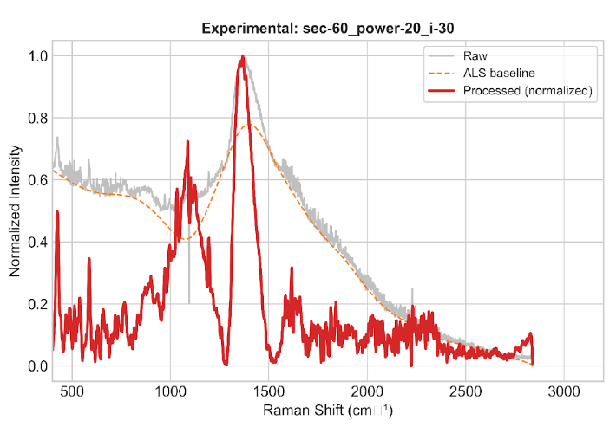
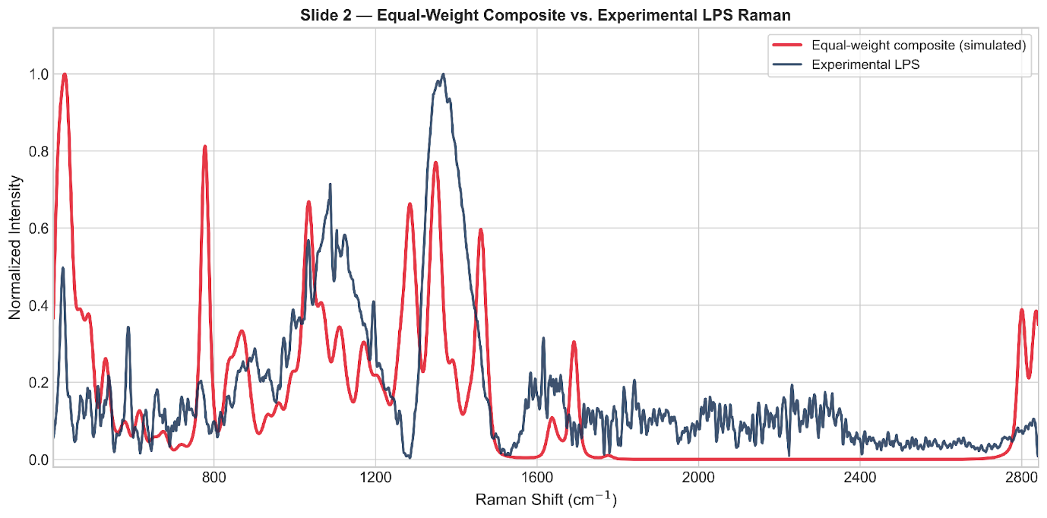
HUNGARIAN PEAK-TO-MODE ASSIGNMENT
Backup — LPS Experimental Spectrum and Composite Fits
Experimental LPS powder spectrum (60 s, 20% power, 30 accumulations)
DFT vibrational modes of the five LPS fragments (178 modes) matched to the experimental spectrum
Model fit quality
Matching approach | Peaks / DFT modes | Peaks matched | Mean absolute error
All matched (Hungarian, ±15 cm⁻¹) | 43 / 178 | 26 (60%) | 3.9 cm⁻¹
Closely matched (Δ ≤ 5 cm⁻¹) | 43 / 178 | 4 | 1.6 cm⁻¹
Seven bands form the characteristic LPS Raman fingerprint: 721, 748, 1659 and 1693 cm⁻¹ agree directly with DFT; 972, 1124 and 1354 cm⁻¹ are additionally confirmed against literature LPS/endotoxin Raman bands (989, 1131 and 1330 cm⁻¹).

Slide 53
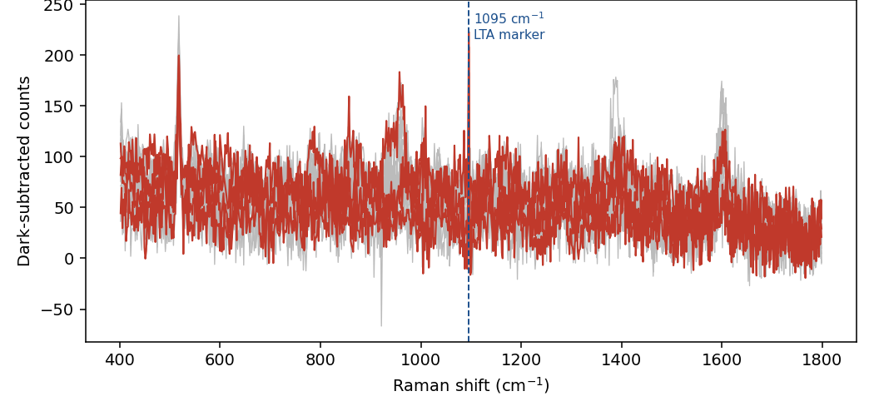
SENSOR 2, 2-MINUTE ETCH
Backup — LTA SERS Trial, All Measurement Spots
Peak-validation methodology
SNR acceptance threshold
A minimum SNR of 3, reproducible across replicate spots, is required for a candidate SERS peak to be accepted.
Peak-width validity
A genuine Raman band should exhibit a multi-pixel width consistent with the instrument response; a single-pixel spike is treated as a detector artifact.
Applied consistently
Established from the LTA investigation and applied to all subsequent SERS peak validation.
LTA on Sensor 2 (2-minute etch) — all 15 measurement spots overlaid
Outcome: the apparent 1095 cm⁻¹ feature (4 of 15 spots at SNR ≥ 3) failed the peak-width criterion and was rejected as a detector artifact. A separate 1602 cm⁻¹ SERS candidate was also assessed and found to coincide with an identical blank-substrate peak (Δ = 0.3 cm⁻¹) — reclassified a substrate artifact, not an LTA signal.

Slide 54
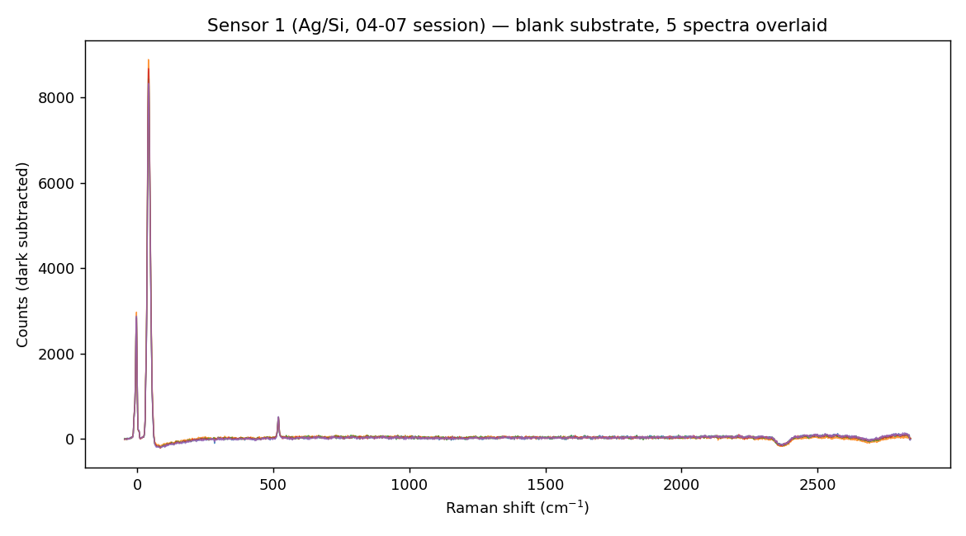
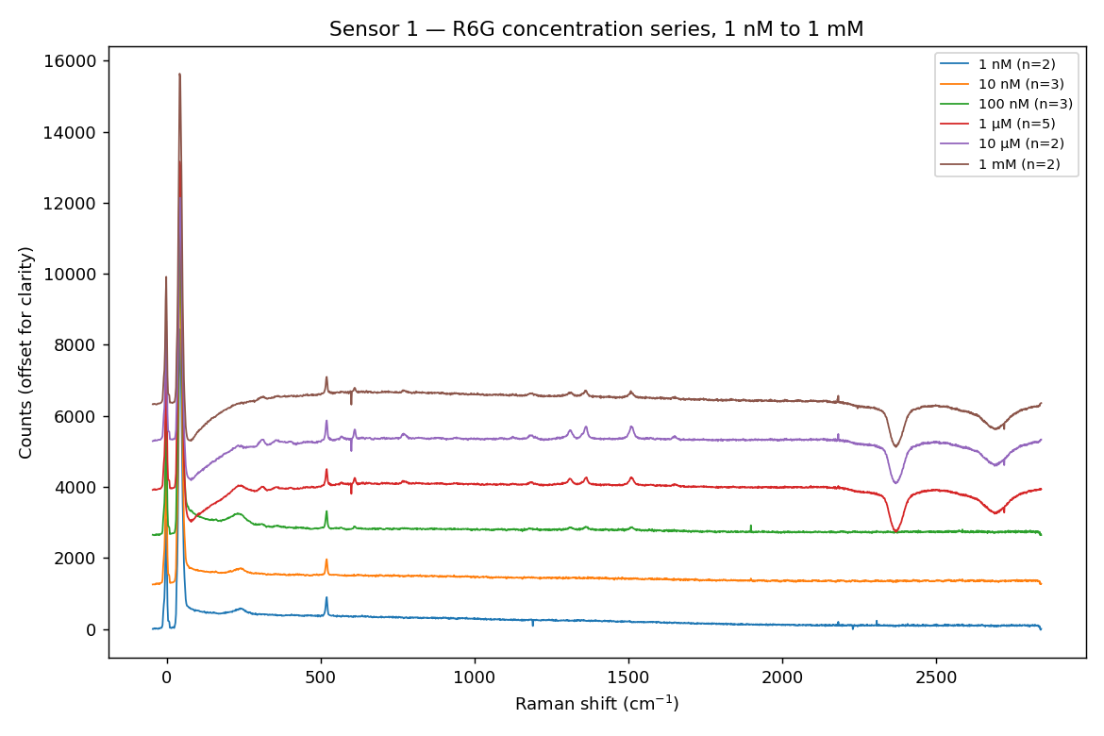
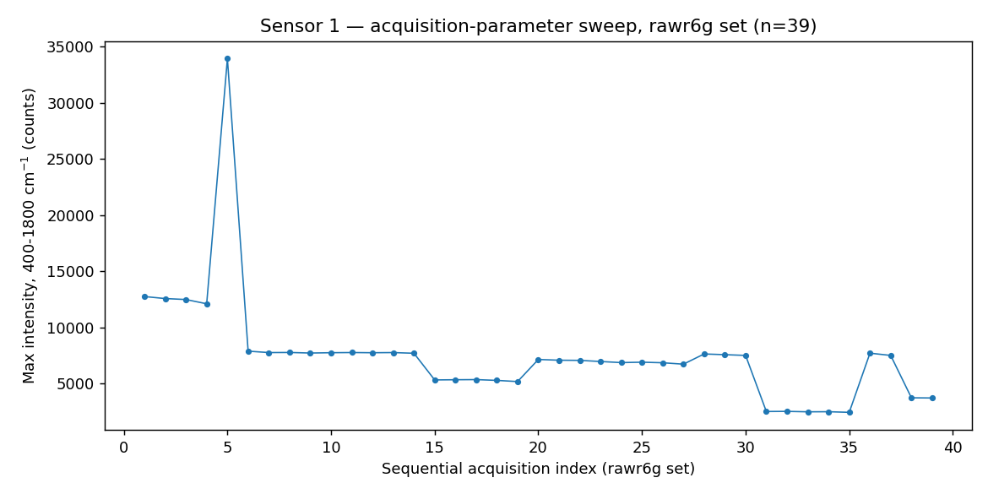
BLANK, CONCENTRATION SERIES AND REPRODUCIBILITY
Backup — Sensor 1 (Ag/Si) R6G Validation Detail
Blank substrate — five spectra overlaid
R6G concentration-response, 1 nM–1 mM
R6G concentration series (stacked)
Outcome
Sensor 1 demonstrated SERS activity and a measurable concentration response across the tested R6G range.
Blank-substrate spectra established the background baseline used for all subsequent subtraction.
The 39-spectrum sweep provided the reproducibility reference for the substrate.
39-spectrum acquisition sweep used for reproducibility assessment

Slide 55
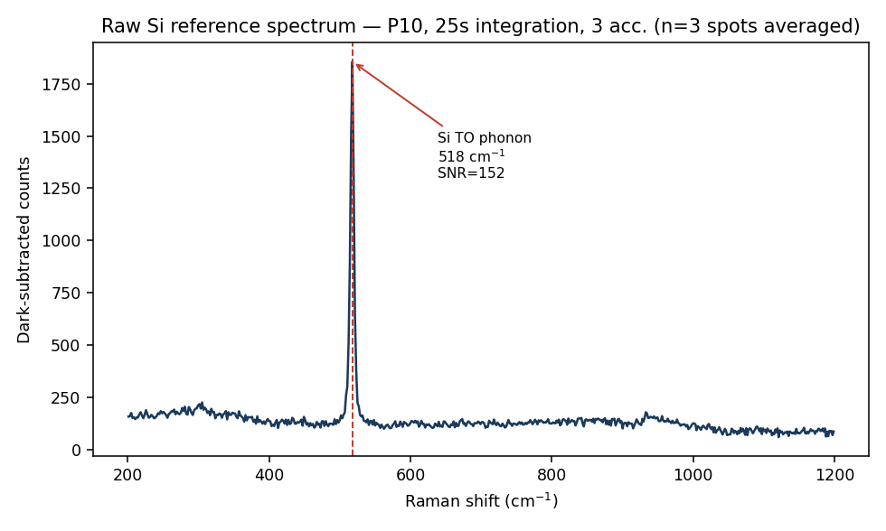
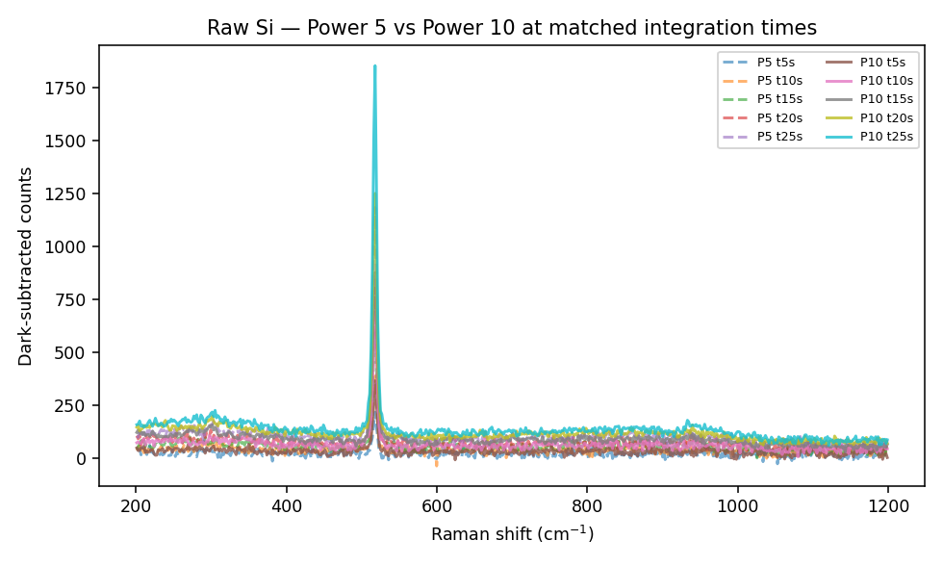
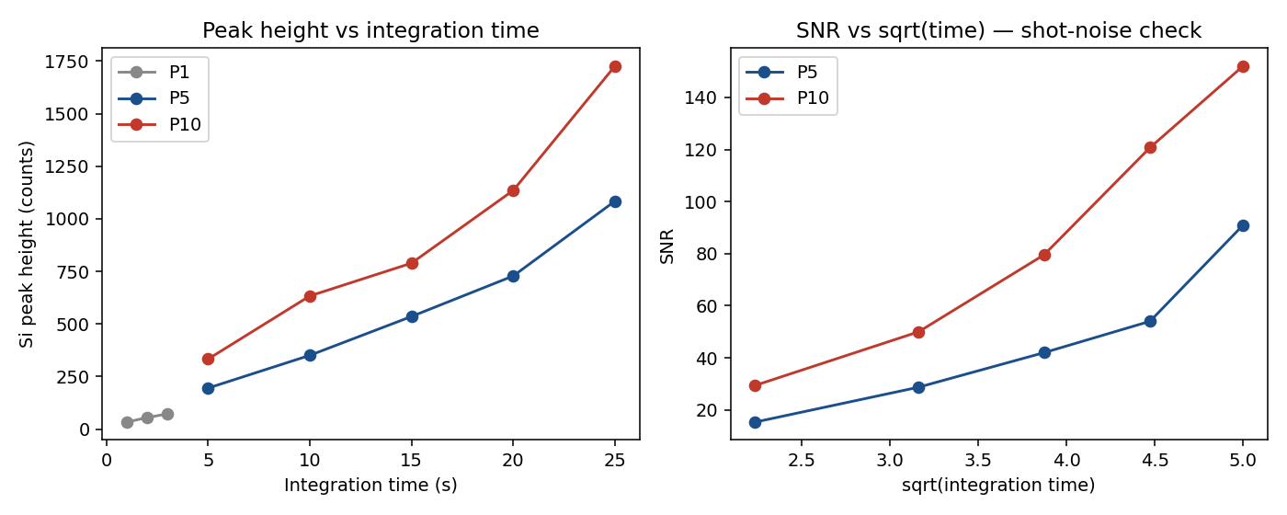
INSTRUMENT REFERENCE MEASUREMENTS
Backup — Raw-Silicon Reference and Wavenumber Calibration
Unetched-silicon reference spectrum (highest-signal condition)
Unetched-silicon spectra across tested laser power settings
Linearity check of the silicon 520 cm⁻¹ phonon reference peak
Purpose: unetched raw-silicon spectra provide the wavenumber calibration reference for the instrument and establish its minimum resolvable peak width — the basis for the multi-pixel peak-validity criterion applied to all SERS candidate peaks in this project.

Slide 56
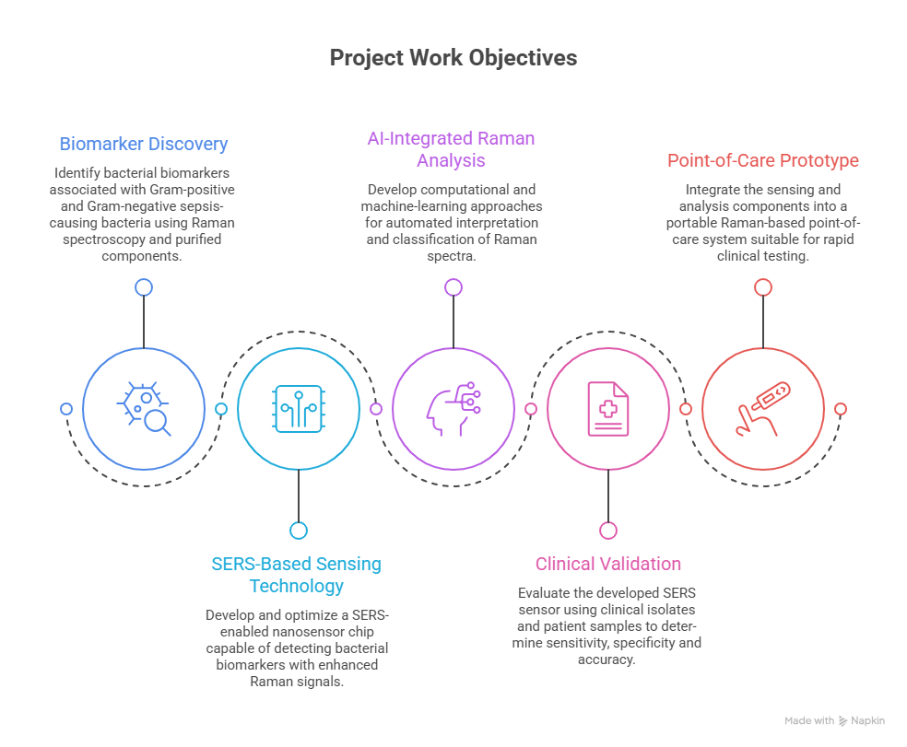
AS PRESENTED IN THE PROJECT REPORT
Backup — Project Objectives (Original Proposal Figure)
Objective summary
Biomarker Discovery
1
SERS-Based Sensing Technology
2
AI-Integrated Raman Analysis
3
Clinical Validation
4
Point-of-Care Prototype
5
Graphical representation of the project objectives

